Slide 1

FANTOM5 time-courses
Carsten O. Daub
2011-10-17

Slide 2
Time-courses – Overview
Timecourse | number of samples | number completed | species | status | collaborator | type
Mesenchymal stem cell differentiation to adipocyte | 48 | 48 | Mouse | COMPLETED | Yasushi Okazaki, Yutaka Nakachi | IN_VITRO DIFFERENTIATION SERIES
Mesenchymal stem cell differentiation to osteocyte | 45 | 45 | Mouse | COMPLETED | Yasushi Okazaki, Yutaka Nakachi | IN_VITRO DIFFERENTIATION SERIES
J2E, eryrthopoietin induced erythrocytic differentiation | 48 | 43 | Mouse | IN_PROGRESS | Peter Klinken, Louise Winteringham | IN_VITRO DIFFERENTIATION SERIES
EBF knockout model of T-cell differentiation | 48 | 28 | Mouse | IN_PROGRESS | Hiroshi Kawamoto, Tomokatsu Ikawa | IN_VITRO DIFFERENTIATION SERIES
Trophoblast stem cell differentiation to trophoblasts | 21 | 19 | Mouse | IN_PROGRESS | Haruhiko Koseki, Mitsuhiro Endoh | IN_VITRO DIFFERENTIATION SERIES
Primary lung epithelial progenitors differentiation towards ciliated epithelial cells | 54 | 0 | Mouse | IN_PROGRESS | Mitsuru Morimoto | IN_VITRO DIFFERENTIATION SERIES
Early hematopoiesis | - | - | Mouse | NOT_ARRIVED_YET | Daisuke Sugiyama | IN_VITRO DIFFERENTIATION SERIES
Visual cortex development | 18 | 18 | Mouse | COMPLETED | Michela Fagiolini, Alka Saxena | DEVELOPMENTAL TISSUE SERIES
Cerebellum development | 48 | 48 | Mouse | COMPLETED | Daniel Goldowitz, Thomas Ha, Peter Zhang | DEVELOPMENTAL TISSUE SERIES
Saos-2 calcification | 54 | 54 | Human | COMPLETED | Kim Summers | IN_VITRO DIFFERENTIATION SERIES
Primary macrophage response to LPS | 77 | 59 | Human | COMPLETED | David Hume, Kenneth Baillie, Geoff Faulkner | IN_VITRO DIFFERENTIATION SERIES
Primary lymphatic endothelial cells response to vascular endothelial growth factor C (VEGFC) | 48 | 48 | Human | COMPLETED | Michael Detmar, Sarah Krampitz | IN_VITRO DIFFERENTIATION SERIES
K562, hemin induced erythocytic differentiation | 54 | 54 | Human | COMPLETED | Peter Klinken, Louise Winteringham | IN_VITRO DIFFERENTIATION SERIES
MCF7 response to epidermal growth factor (EGF) | 48 | 34 | Human | IN_PROGRESS | Mariko Okada(Hatakeyama) | IN_VITRO DIFFERENTIATION SERIES
MCF7 response to heregulin (HRG) | 45 | 31 | Human | IN_PROGRESS | Mariko Okada(Hatakeyama) | IN_VITRO DIFFERENTIATION SERIES
Embryonic stem cells differentiated to melanocytes | 48 | 47 | Human | IN_PROGRESS | Meenhard Herlyn, Rolf Swoboda | IN_VITRO DIFFERENTIATION SERIES
Primary macrophage response to Udorn strain Influenza virus | 24 | 8 | Human | IN_PROGRESS | David Hume, Kenneth Baillie, Geoff Faulkner | IN_VITRO DIFFERENTIATION SERIES
Primary preadipocyte to adipocyte differentiation | 12 | 3 | Human | IN_PROGRESS | Peter Arner, Niklas Mejhert, Erik Arner | IN_VITRO DIFFERENTIATION SERIES
Embryonic stem cells differentiation to cardiomyocyte | 48 | 0 | Human | IN_PROGRESS | Christine Mummery, Robert Passier | IN_VITRO DIFFERENTIATION SERIES
Mesenchymal stem cells differentiation to adipocytes | 54 | 2 | Human | IN_PROGRESS | Peter Arner, Niklas Mejhert, Erik Arner | IN_VITRO DIFFERENTIATION SERIES
Primary aortic smooth muscle cells response to fibroblast growth factor 2 (FGF2) | 30 | 20 | Human | IN_PROGRESS | Levon Khachigian | IN_VITRO DIFFERENTIATION SERIES
Primary aortic smooth muscle cells response to interleukin 1 beta (IL1b) | 30 | 19 | Human | IN_PROGRESS | Levon Khachigian | IN_VITRO DIFFERENTIATION SERIES
iPS differentiation to neuron | 48 | 0 | Human | IN_PROGRESS | Christine Wells | IN_VITRO DIFFERENTIATION SERIES
Primary myoblast differentiation to myotube | 54 | 0 | Human | IN_PROGRESS | Valerio Orlando, Beatrice Bodega | IN_VITRO DIFFERENTIATION SERIES
Embryonic stem cell differentiation to CD34+ hematopoietic stem cells | 9 | 0 | Human | IN_PROGRESS | Kim Summers | IN_VITRO DIFFERENTIATION SERIES
APRE-19 retinal pigment epithelial cell line, epithelial to mesenchyme transition | 48 | 0 | Human | NOT_ARRIVED_YET | Soichi Ogishima | IN_VITRO DIFFERENTIATION SERIES
Chick embryonic development | 26 | 7 | Chicken | IN_PROGRESS | Guojun Sheng | DEVELOPMENTAL TISSUE SERIES

Slide 3
Matching Samples
Mouse
Human
Mesenchymal stem cell differentiation to adipocyte
J2E, eryrthopoietin induced erythrocytic differentiation
Early hematopoiesis
Mesenchymal stem cells differentiation to adipocytes
K562, hemin induced erythocytic differentiation
Embryonic stem cell differentiation to CD34+ hematopoietic stem cells

Slide 4
Time-course Wiki page
Overview and status of time-courses
Details for each time-course
Access to
  Descriptions
  Data
  ZENBU configs
Entry point for collaborators
  Please use the Wiki

Slide 5
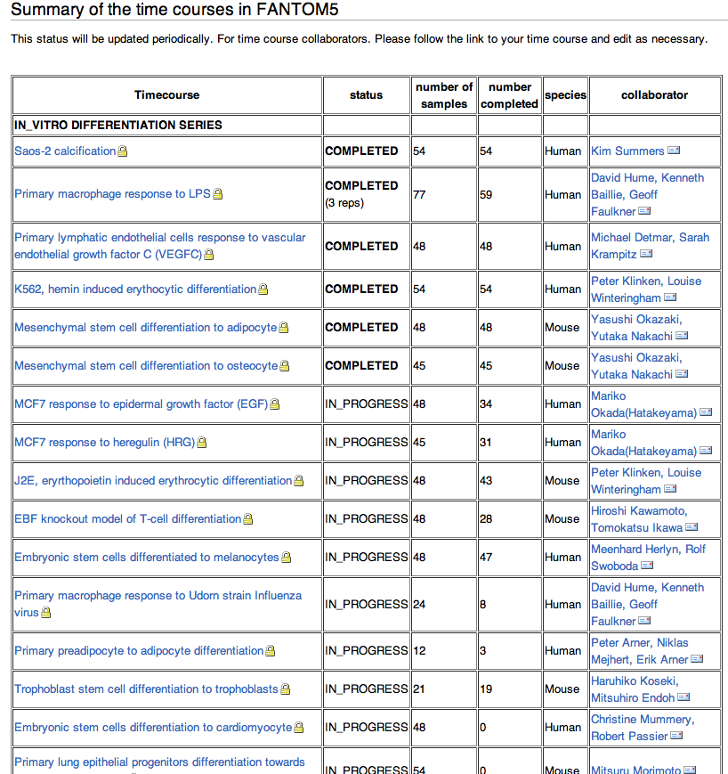
Time-course Wiki

Slide 6
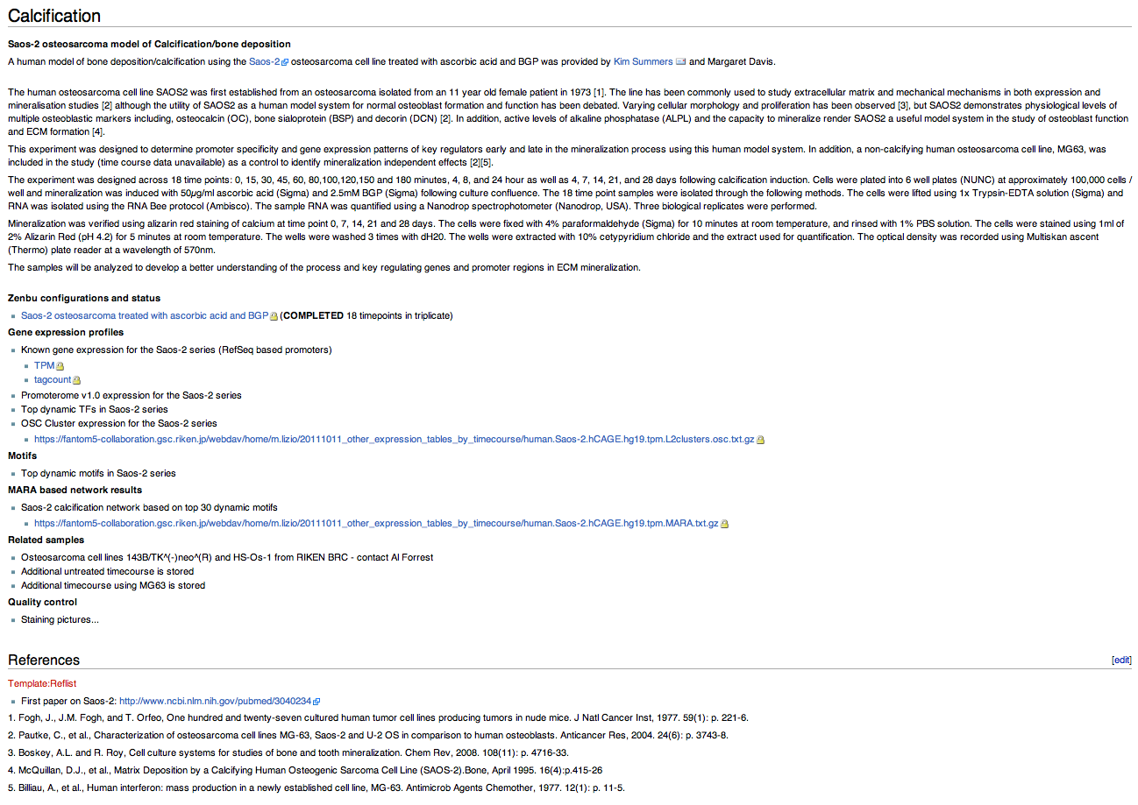

Slide 7
Data Analysis

Slide 8
Data quality and normalization
Essential preparations for analysis consistent
  within one time-course
  Among time-courses
  Across species (human-mouse matching samples)
Data filtering
Normalization
Synchronization between time-points
  Within sample
  Slow and fast time-courses
Important non-trivial aspect!
  Effort might be as complex as clustering?

Slide 9
Main Paper – Questions
How does the differentiation machinery work?
  Are the same sets of elements driving the early response in differentiation? Some set of factors always shows up? Are there agitator-type factors?
  What are the elements?
  How are the elements regulated?
    What pathways are used?
What is specific for each differentiation?
Is the mouse a good model for differentiation?

Slide 10
Main Paper – The Elements
TFs important for differentiation
TFBS important for differentiation
  Switching TSS
ncRNA driving/ involved in differentiation
Pathway analysis
S/AS expression

Slide 11
Main Paper – Methods
Key genes and motifs specific for each differentiation
  Expression clustering
    on gene level and tag cluster (TC) level
    Early, middle, late, other expressed: genes and TCs
  Motif activity clustering
    Early, middle, late , other

Slide 12
Biological findings
Additionally to the global concepts:
  For one time-course we show biological findings, for example novel key-regulatory event
    Maybe incl. human-mouse comparison

Slide 13
Outline Time-course session
Presentation of
  biology of differentiation
  samples
Discussion session
  Bring together sample providers and Bioinformatics analysis groups
  Other relevant topics?
    Data normalization, synchronization, etc.

