Slide 1


Investigating Transcriptional Plasticity Using CAGE Data
Jess Mar
jessica.mar@einstein.yu.edu
Department of Systems & Computational Biology
Albert Einstein College of Medicine
FANTOM 5 Koyo Meeting, RIKEN OSC, 19 October 2011
Notes:
Opening points – say thank you to everyone (Al, Piero, YH).

Slide 2
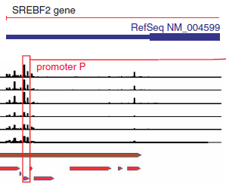
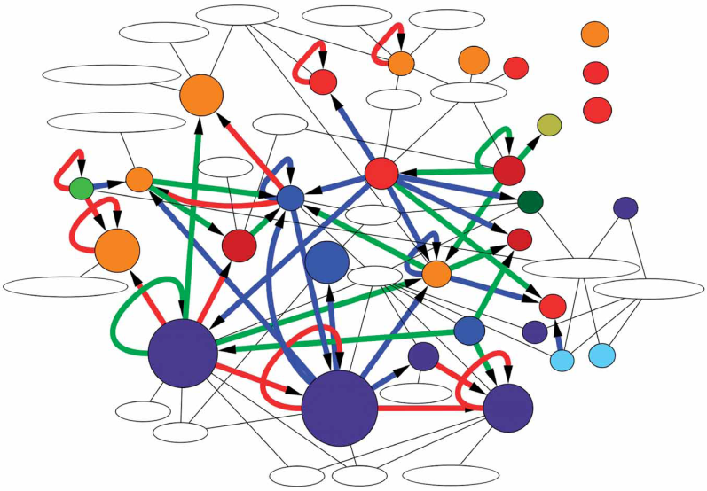
Promoter Usage is Dynamic
FANTOM4 demonstrated how promoter activation is dynamically regulated during differentiation of the THP-1 cell line.
+ MARA
+ JASPAR
+ TRANSFAC
Time
Infer a subset of critical regulatory relationships.
The FANTOM Consortium & the RIKEN OSC, Nature Genetics (2009).

Slide 3
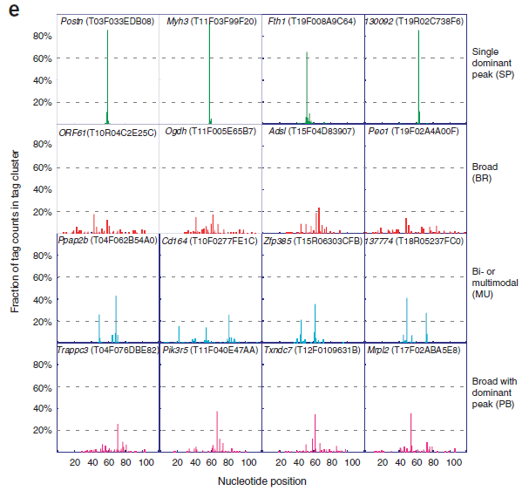
Promoters Have Different Classes of Plasticity
FANTOM3 revealed four dominant classes of promoter shapes which have different regulatory elements, sequence-based properties and frequency in the genome.
Single Dominant Peak
Broad Shape
Multi-modal Peaks
Broad with Dominant Peak
Carninci P et al., Nature Genetics (2006).

Slide 4



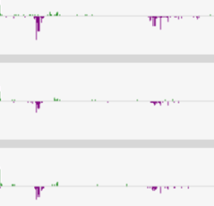

Plasticity in FANTOM 5
Wells Lab Human Monocyte Infection Panel
Donor-derived samples allow us to probe plasticity.
Donor 1, Mock-Control
Donor 2, Mock-Control
Donor 3, Mock-Control
HG19.chr1 - IL10
Anthony Beckhouse

Slide 5
Cell populations are inherently heterogeneous
Variance in expression can be a surrogate measure which reflects this heterogeneity.
Christine Wells
Notes:
The question is whether the observations are equally effecting all members, or reflecting diversification of the population itself.

Slide 6
Variation Occurs at All Levels of Regulation
Confers robustness and underlies phenotypic diversity.
protein
Physical variants (variation in receptors, etc).
Gene expression
microRNA
RNA
Structural variants:
Deletions,
Duplications &
Inversions.
SNPs & Haplotypes
DNA
Promoter complexity – Transcriptional Start Sites, Enhancers, Insulators, etc.
Epigenetics

Slide 7
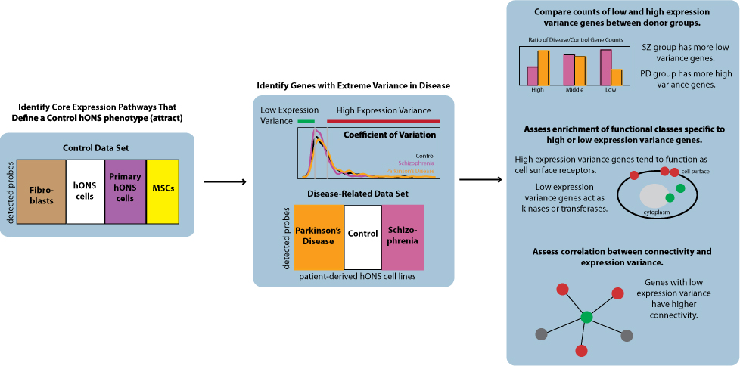
Can we identify patterns of expression variance that are informative of the disease phenotype?
Which genes have high variance across patients in the same disease group?
How is this distributed through the genome?
Mar et al. (2011) PLoS Genetics.

Slide 8
Interpreting population variance with respect to regulatory networks

Slide 9
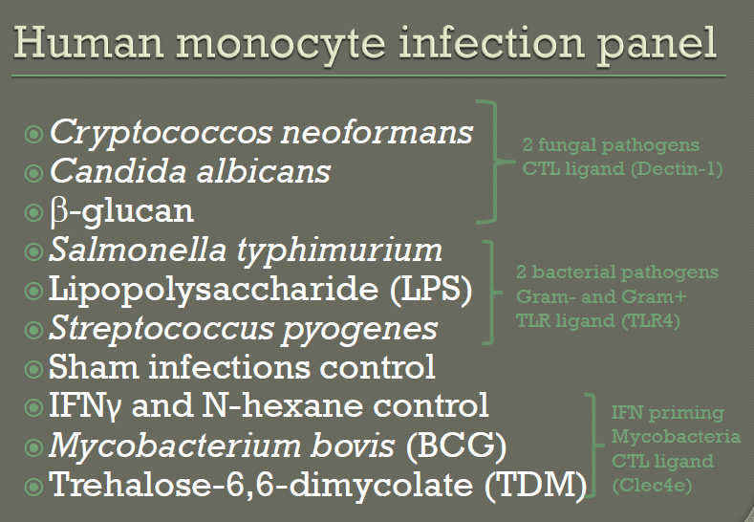
Christine Wells, Anthony Beckhouse

Slide 10
Donor Plasticity: We would like to derive/borrow methods to determine genes that fall into the following two categories:
Donor 1
Donor 1
5’
Gene x
5’
Gene Y
Donor 2
Donor 2
5’
Gene x
5’
Gene Y
Donor 3
Donor 3
5’
Gene x
5’
Gene Y
Genes which have more plasticity/variability across donors.
Genes which have uniform distributions across donors.

Slide 11
Infection-specific Plasticity:
Genes whose promoter shapes change based on condition, consistently through the population.
Donor 1 + Mock
Donor 1 + BCG
Donor 1 + Candida
5’
Gene x
5’
Gene x
5’
Gene x
Donor 2 + Mock
Donor 2 + BCG
Donor 2 + Candida
5’
Gene x
5’
Gene x
5’
Gene x
Donor 3 + Mock
Donor 3 + BCG
Donor 3 + Candida
5’
Gene x
5’
Gene x
5’
Gene x

Slide 12
Question: are genes with more transcriptional plasticity more likely to occur at points in the signaling pathways that confer regulatory roles in buffering noise?
Receptor B
Receptor A
Receptor C
cell surface
underlying gene regulatory network

Slide 13
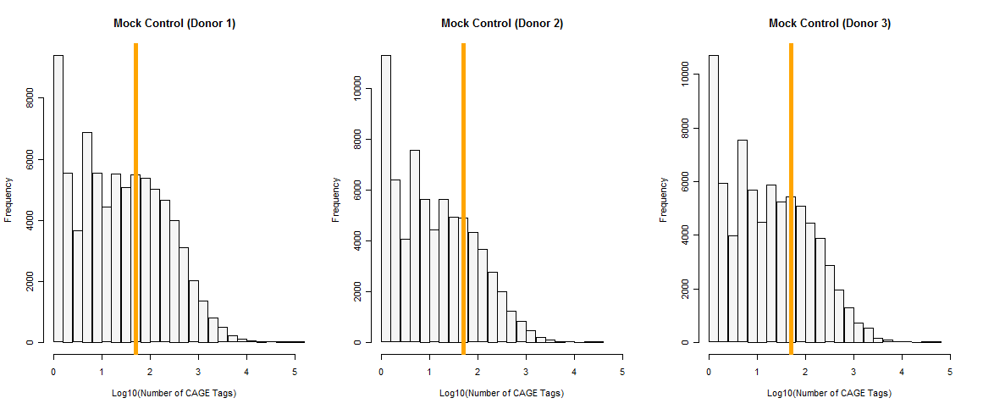
Assessing the coverage of CAGE tags falling within Gencode-defined transcript regions
Notes:
Orange line represents log10(50) = this is the cut-off we took to proceed further.

Slide 14
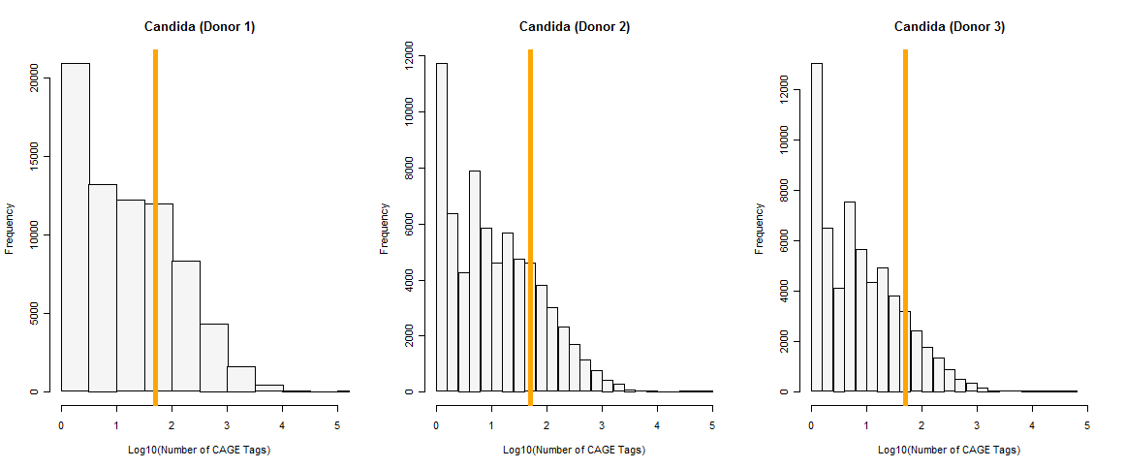
Assessing the coverage of CAGE tags falling within Gencode-defined transcript regions

Slide 15
Some Numbers
For mock-control samples, donors 2 and 3 have 18192 gene regions that have at least 50 CAGE tags mapped.
For the Candida infection, donors 2 and 3 have 9090 gene regions.
There are 8384 gene regions that have at least 50 CAGE tags in both mock-control and Candida infection sets (donors 2 and 3).

Slide 16
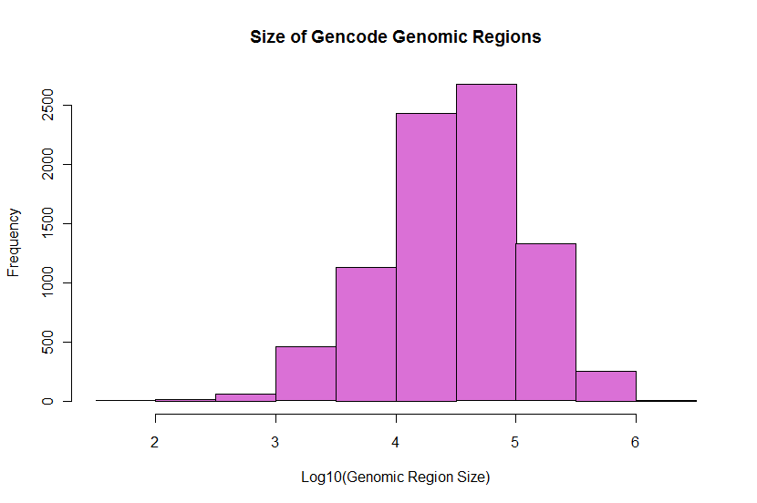
Notes:
How big are these Gencode-defined regions? If they are too small then we should not bother but it looks like these regions are fairly large (although obviously there is a range).

Slide 17
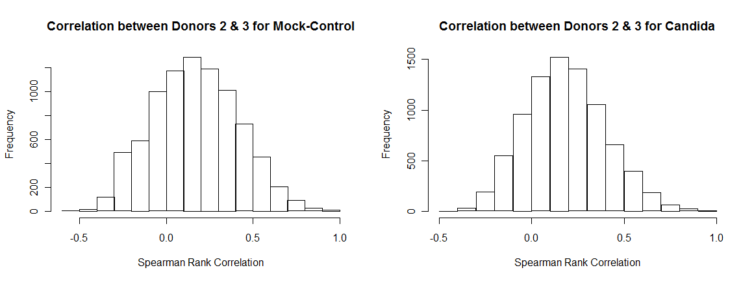
A spectrum spanning consistent to non-consistent cluster shapes exists.

Slide 18
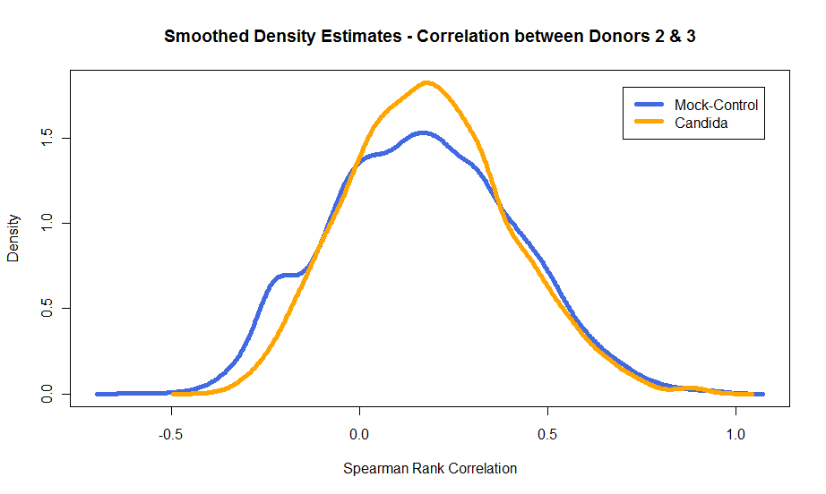
Some differences between mock and Candida infection emerge

Slide 19
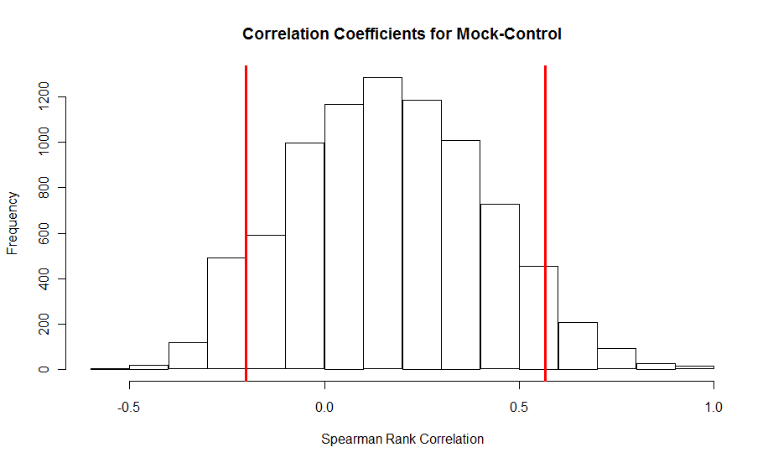
MOCK Control
KEGG Terms (Adjusted P-value < 0.1)
hsa03010:Ribosome
hsa05012:Parkinson's disease
hsa00190:Oxidative phosphorylation
hsa05016:Huntington's disease
hsa05010:Alzheimer's disease
hsa04260:Cardiac muscle contraction
hsa03050:Proteasome
hsa04010:MAPK signaling pathway (P = 0.071)
hsa04330:Notch signaling pathway (P = 0.099)

Slide 20
Candida Infection
KEGG Terms (Adjusted P-value < 0.1)
hsa03010:Ribosome (P = 7.5E-29)
hsa00190:Oxidative phosphorylation
hsa05012:Parkinson's disease
hsa05016:Huntington's disease
hsa05010:Alzheimer's disease
hsa05130:Pathogenic Escherichia coli infection
hsa03050:Proteasome
hsa04260:Cardiac muscle contraction
(P = 0.091)
No significant results.

Slide 21
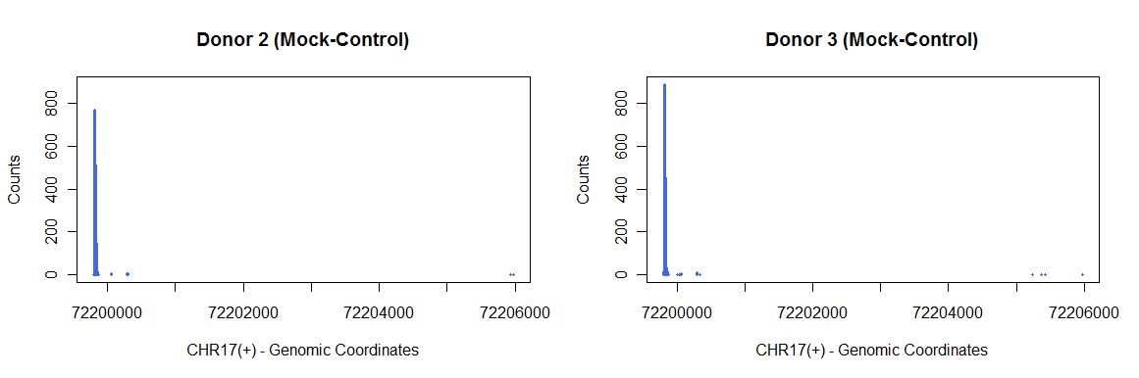
Sanity Checking Our Metric
ENST00000311111 (ribosomal protein L38) is our most highly-correlated gene in the Ribosome pathway.
Notes:
RPL38-001 = ribosomal protein L38

Slide 22
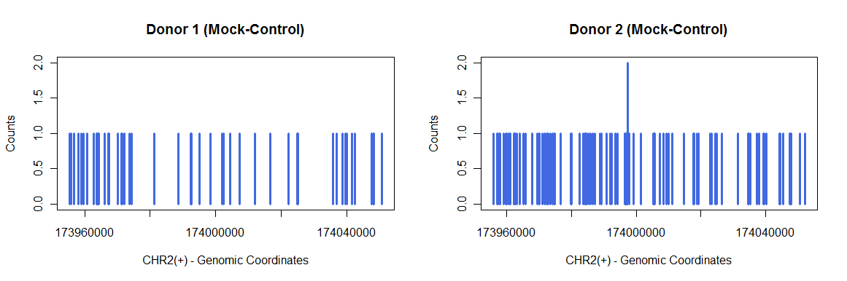
Similarly, in the other direction…
ENST00000422149 (MAPK kinase kinase MLT) is our most negatively-correlated gene in the MAPK pathway.

Slide 23
Future Directions
We need to collect more donors to be able to make stronger statements about “donor”-plasticity.
More robust statistical methods likely exist to pick up donor-specific, infection-specific changes in promoter shapes.
Interpretations of plasticity in the context of functional and regulatory consequences will involve integration with network models.

Slide 24

Acknowledgements
AIBN
Anthony Beckhouse
Christine Wells
Kelly Hitchens
Dipti Vijayan
RIKEN OSC
Al Forrest
Hideya Kawaji
Yoshihide Hayashizaki
jessica.mar@einstein.yu.edu

