Slide 1
Preferred Pair Distance Distributions and Templates (PPDD/T) to detect composite elements of transcription factor binding sites
Case study on MCF7 timecourse data
VIGG: Ivan Kulakovskiy, Ilya Vorontsov, Vsevolod Makeev
KAUST: Yulia Medvedeva, Ulf Schaefer
& Sebastian Schmeier

Slide 2
General workflow
Learn distance preferences (“PPD distributions”) for TFBSs of interacting proteins using genome-wide set of promoters;
Detect highly preferred distances between TFBSs (“PPD templates”);
Detect differentially expressed (DE) CTSSs for each point of a timecourse;
Check if DE promoters are enriched with composite elements made of TFBSs located at preferred distances.

Slide 3
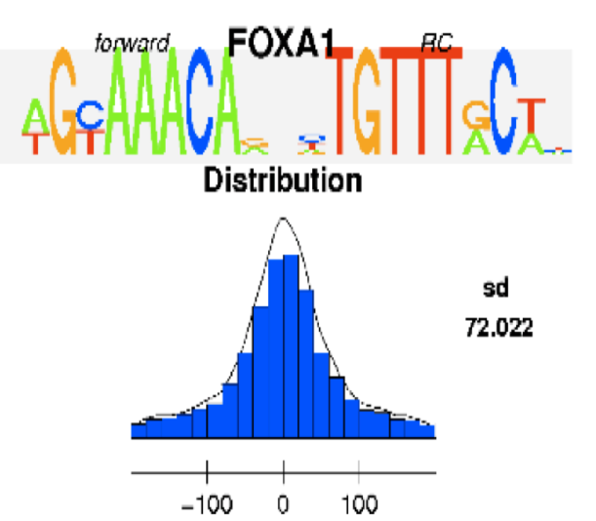
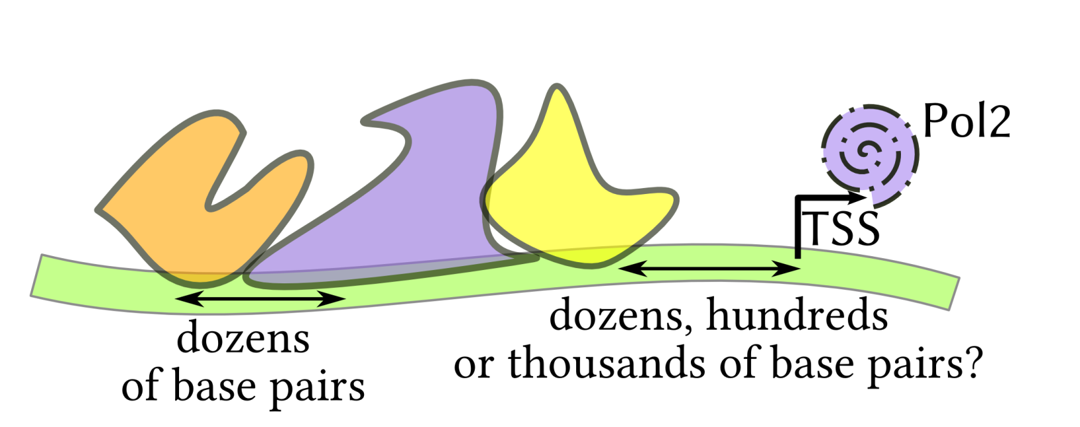
What is generally accepted for composite elements?
Nearby TFBS possibly can form composite elements (several examples in TRANSCompel, BioBase).
It is possibly enough for TFBS to be nearby (e.g. rGADEM, Mercier et al.).

Slide 4
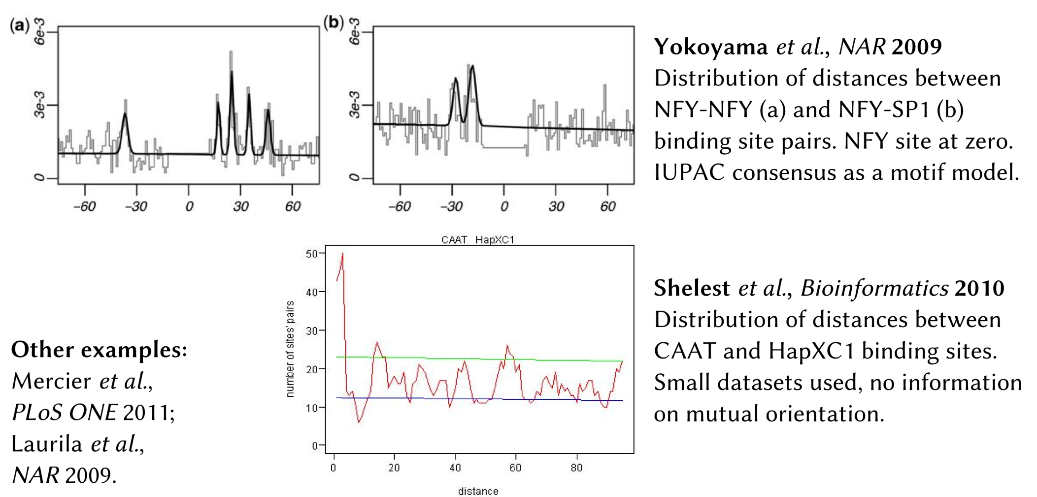
What is really observed for PWM hits in genome?

Slide 5
The basics of PPDD/T
Predict TF binding sites using two PWMs for TFBS of interacting TFs in the genome-wide set of human promoters;
agtgtgatgtgacAAAATTAAAAAggcggcggacCTCGTGagtcgtagctg
Drop overlapping TFBS pairs;
Count the number of promoters having a given TFBS pair in a given mutual orientation separated by a given spacer;
Repeat the steps 1-3 for sequences with shuffled letters (shuffled genome-wide) and for sequences after polyN masking of repeats/exons.

Slide 6
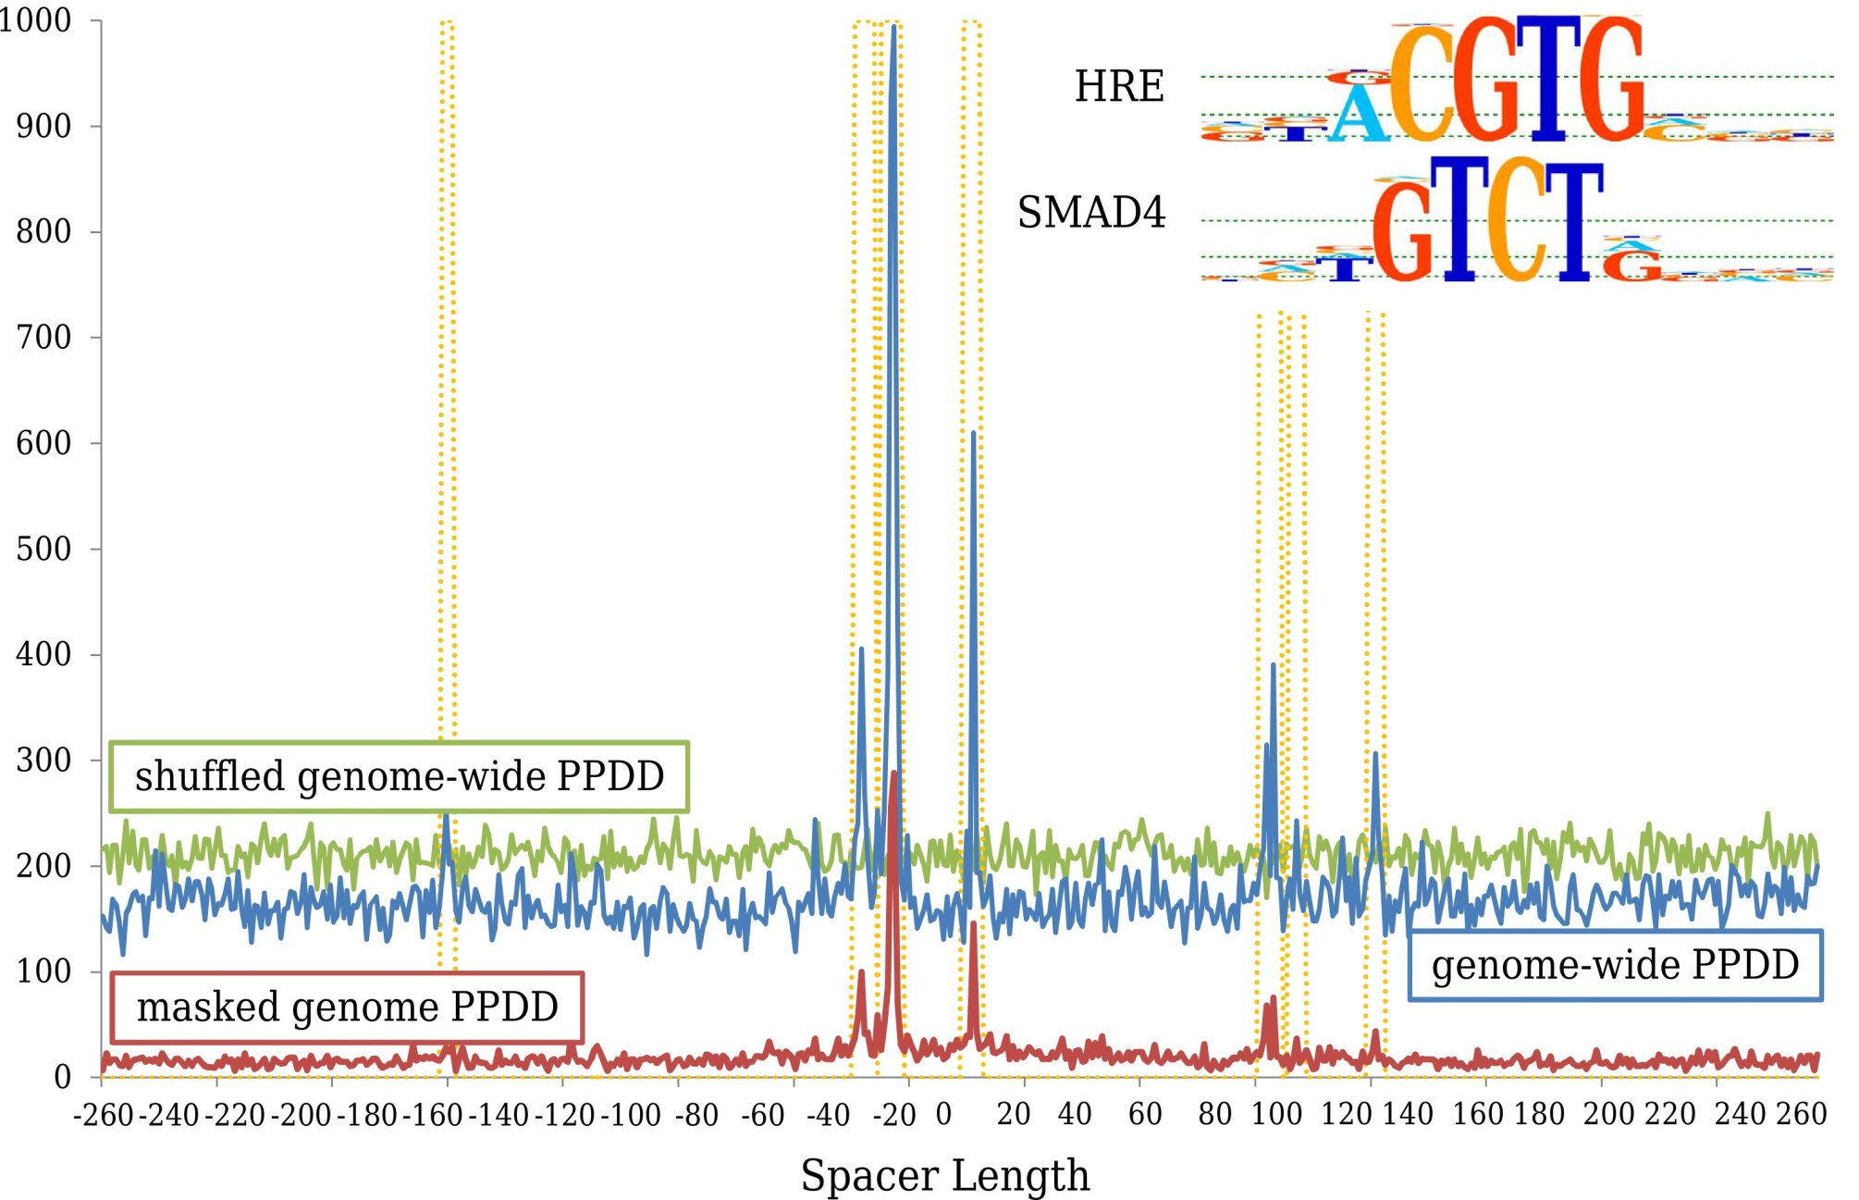
The basics of PPDD/T

Slide 7
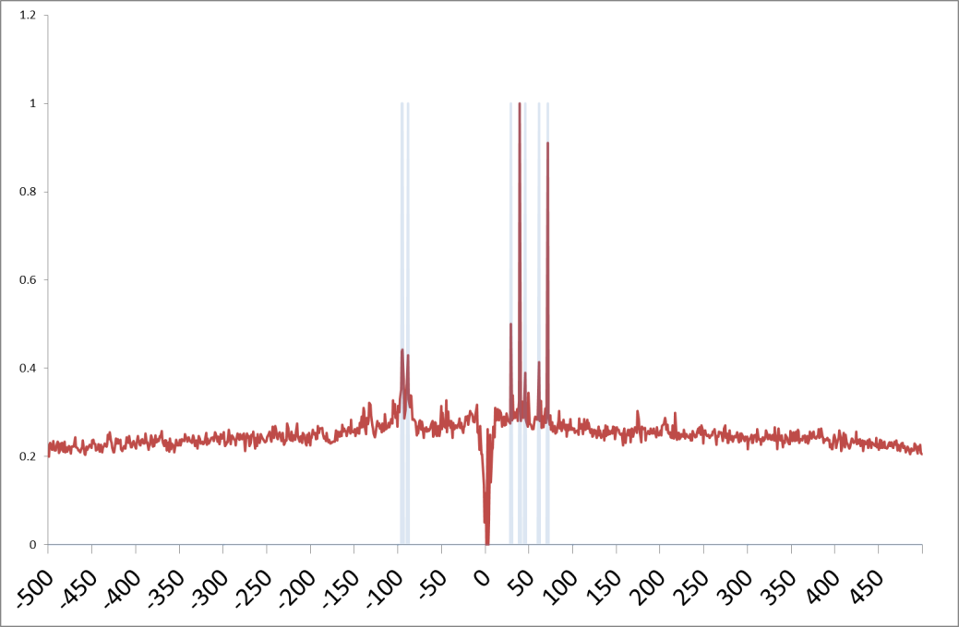
Learning PPDD/T
HOCOMOCO
TFBS models
A-D quality
TcoF
TF interactions:
direct interaction,
physical association
+
pair of TFBS models for interacting TFs
genome-wide set of promoters
[-1500;+500]
+

Slide 8
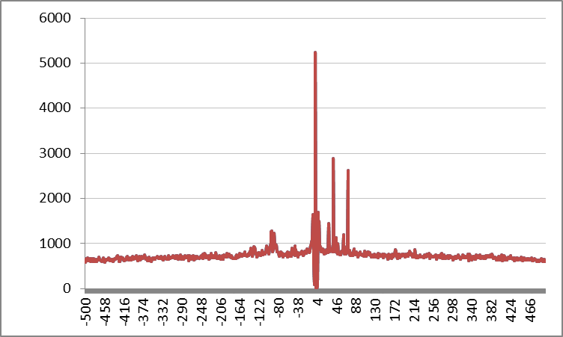
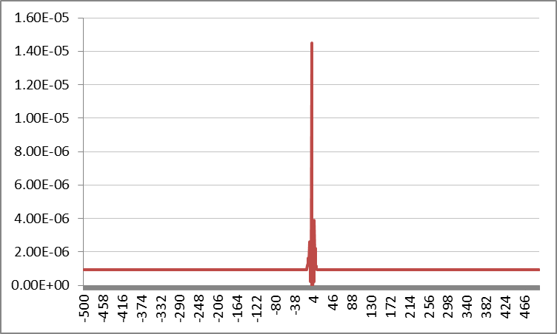


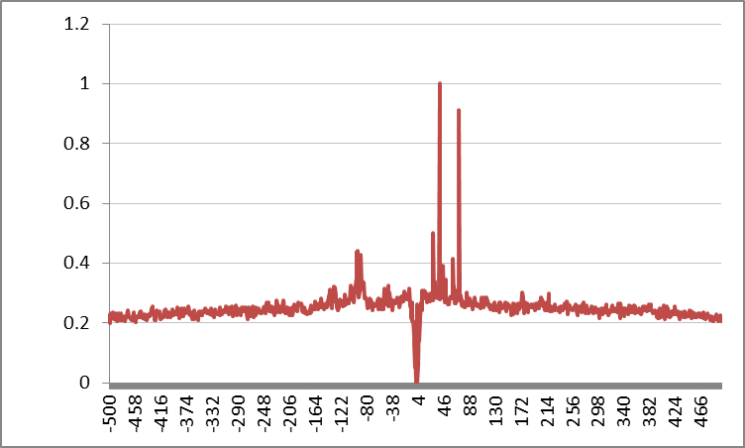
Normalizing PPDD/T
Count observed number of promoters with a given TFBS pair in a given orientation with a given “shift”;
Compute expected frequency of “target” TFBS with a given shift relative to the “anchor”;
Compute PPDD as observed / expected, normalize the final curve.

Slide 9
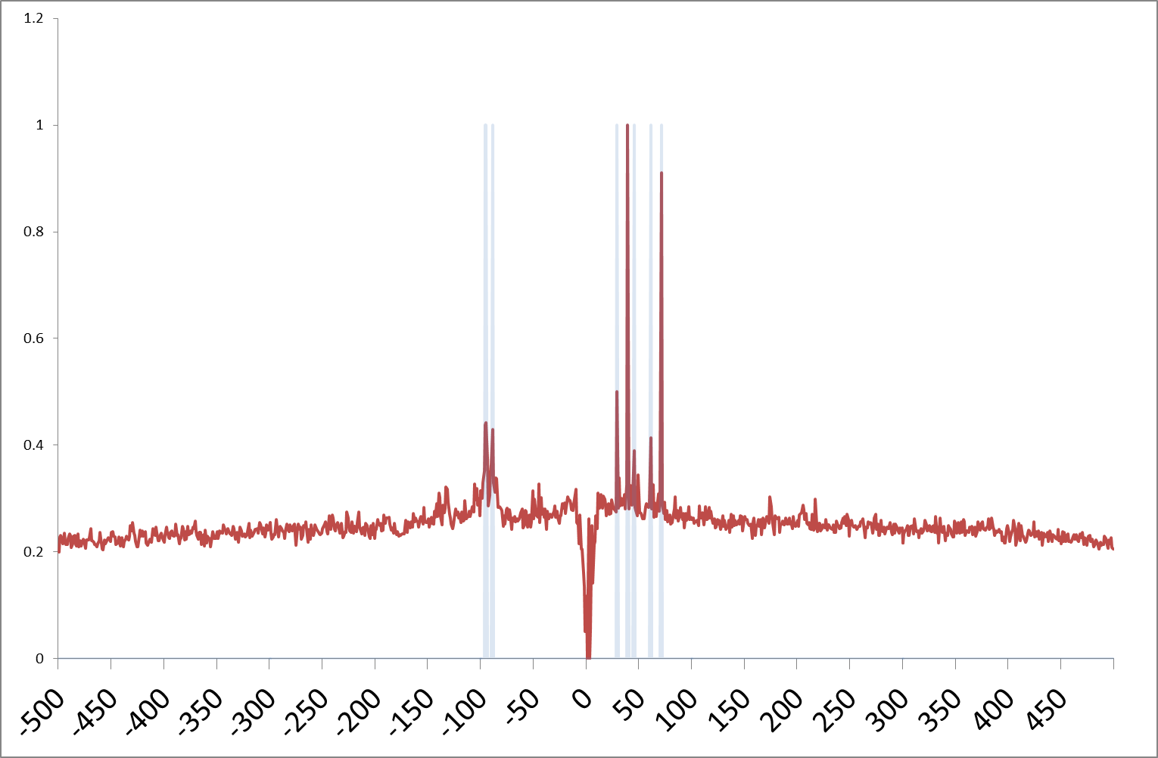


PPDD/T in details
1. Narrow “peaks” are common for TFBS pairs;
2. Closest distances often correspond to known composite elements [Shelest et al., DistanceScan];
3. Distant “peaks” arise in not-so-proximal promoters;
4. “Peaks” are not coming from repeats/exons/etc [Kulakovskiy et al., 2011];
5. For regulated promoters, composite elements of TFBSs on preferred distances are enriched [Kulakovskiy et al., 2011] but difficult to detect directly (possibly
due to homotypic clusters).
“peaks”

Slide 10
PPDD/T in details
X axis – shift of the ‘target’ PWM relative to the ‘anchor’
Y axis –normalized number of promoters having a given TFBS pair in a given orientation
Promoters:
[-1500:+500] for anchor TFBSs;
[-2000:+1000] for target TFBSs.
Hif1-alpha (anchor) versus Sp-1 (target) in direct orientation

Slide 11
PPDD/T in details
Some tricky points:
- careful PPDD normalization for overlapping PWMs; done using MACRO-APE;
- the length of “promoters” (different distances for proximal vs distant elements)
- PWM threshold selection (P-value of 0.001 = 1 random hit per 1000bps); PPDD is robust if lower thresholds are used [Kulakovskiy et al., 2011];
- only subset of PPDD/T-consistent distances is conservative in human and mouse; more detailed analysis is planned;
- template construction = narrow peak detection (PPDD > mean+s.d.; left and right numerical derivative > mean+s.d.); more robust procedure is necessary, suggestions are very welcome.

Slide 12
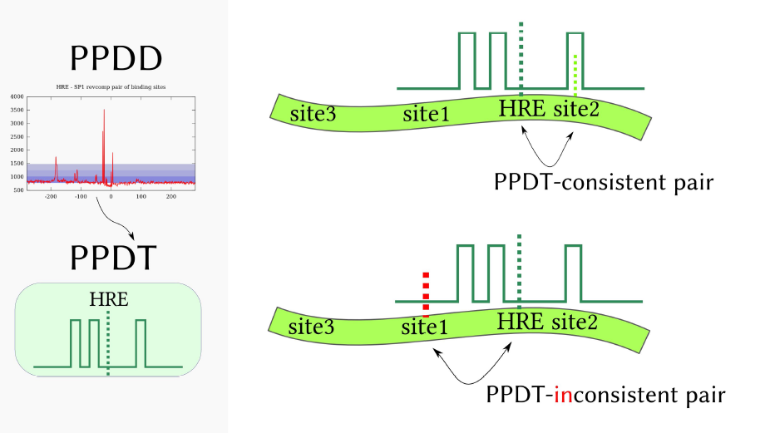
Defining PPDD/T-consistent TFBS pairs
Example for HRE (hypoxia-response element) as the “anchor” TFBS.

Slide 13
Using PPDD/T for timecourse data
edgeR
detect DE genes
vs 00h00min timepoint,
P-value of 0.05
PPDD/T for interacting TFs
full set of timecourse promoters
[-1500;+500]
+
+
detect promoters with PPDD/T-consistent pairs
based on “human” PPDD/T
Timecouses
used as a case study:
MCF7 response to Epidermal Growth Factor(EGF), “proliferation”
MCF7 response to Heregulin(HRG), “differentiation”
https://fantom5-collaboration.gsc.riken.jp/wiki/index.php/MCF7_timecourses
apply Fisher’s exact test with Bonferroni correction to number of tested TFBS pairs * 2
(for 2 orientations)

Slide 14
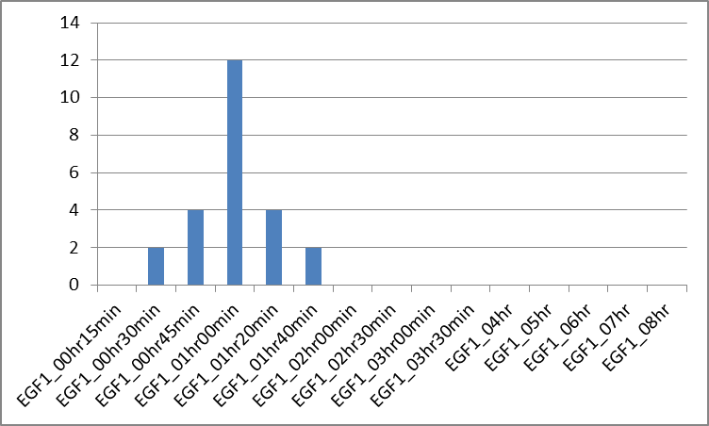
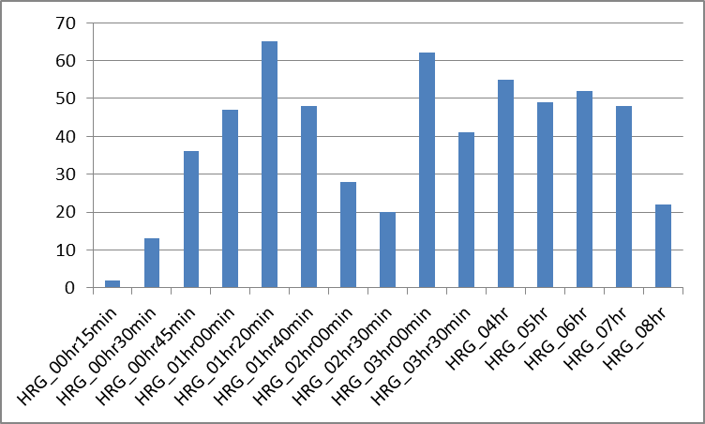
The number of “active” TF pairs
computed as the number
of TF pairs with composite elements
passing the Fisher’s test with P-value of 0.005
“critical” points:
1 hour of MCF7-EGF1 timecourse
1:20 and 3 hours of MCF7-HRG timecourse

Slide 15
Results for MCF7 -EGF1 timecourse
 | EGF1_00hr15min | EGF1_00hr30min | EGF1_00hr45min | EGF1_01hr00min | EGF1_01hr20min | EGF1_01hr40min | EGF1_02hr00min | EGF1_02hr30min | EGF1_03hr00min | EGF1_03hr30min | EGF1_04hr | EGF1_05hr | EGF1_06hr | EGF1_07hr | EGF1_08hr
ATF6A_si^NFYC_f1@direct | 0 | 0 | 0 | 2 | 0 | 0 | 0 | 0 | 0 | 0 | 0 | 0 | 0 | 0 | 0
ETS1_si^TAL1_f1@direct | 0 | 0 | 0 | 2 | 2 | 0 | 0 | 0 | 0 | 0 | 0 | 0 | 0 | 0 | 0
MYOG_f1^TFE2_f2@revcomp | 0 | 0 | 0 | 3 | 0 | 0 | 0 | 0 | 0 | 0 | 0 | 0 | 0 | 0 | 0
NFYB_f1^P53_f2@revcomp | 0 | 0 | 0 | 2 | 0 | 0 | 0 | 0 | 0 | 0 | 0 | 0 | 0 | 0 | 0
NFYC_f1^ATF6A_si@direct | 0 | 0 | 0 | 2 | 0 | 0 | 0 | 0 | 0 | 0 | 0 | 0 | 0 | 0 | 0
P53_f2^NFYB_f1@revcomp | 0 | 0 | 0 | 2 | 0 | 0 | 0 | 0 | 0 | 0 | 0 | 0 | 0 | 0 | 0
P73_si^CEBPZ_si@direct | 0 | 0 | 1 | 0 | 0 | 0 | 0 | 0 | 0 | 0 | 0 | 0 | 0 | 0 | 0
PAX5_f1^RUNX1_f1@revcomp | 0 | 6 | 8 | 9 | 6 | 3 | 0 | 0 | 0 | 0 | 0 | 0 | 0 | 0 | 0
RUNX1_f1^PAX5_f1@revcomp | 0 | 6 | 8 | 9 | 6 | 3 | 0 | 0 | 0 | 0 | 0 | 0 | 0 | 0 | 0
SMAD4_si^SP1_f1@direct | 0 | 0 | 0 | 1 | 0 | 0 | 0 | 0 | 0 | 0 | 0 | 0 | 0 | 0 | 0
SRBP2_f1^NFYC_f1@direct | 0 | 0 | 0 | 2 | 1 | 0 | 0 | 0 | 0 | 0 | 0 | 0 | 0 | 0 | 0
TFE2_f2^MYOG_f1@revcomp | 0 | 0 | 0 | 1 | 0 | 0 | 0 | 0 | 0 | 0 | 0 | 0 | 0 | 0 | 0
XBP1_f1^XBP1_f1@direct | 0 | 0 | 2 | 2 | 0 | 0 | 0 | 0 | 0 | 0 | 0 | 0 | 0 | 0 | 0
Unfortunately PAX5 and RUNX1
PWMs have low (D) quality in HOCOMOCO
Values in cells:
-log10( Fisher’s P-value)

Slide 16
Results for MCF7-HRG timecourse
 | HRG_00hr15min | HRG_00hr30min | HRG_00hr45min | HRG_01hr00min | HRG_01hr20min | HRG_01hr40min | HRG_02hr00min | HRG_02hr30min | HRG_03hr00min | HRG_03hr30min | HRG_04hr | HRG_05hr | HRG_06hr | HRG_07hr | HRG_08hr
SP1_f1^EGR1_f2@direct | 1 | 2 | 2 | 2 | 7 | 5 | 2 | 3 | 13 | 8 | 7 | 9 | 8 | 6 | 4
EGR1_f2^SP1_f1@direct | 0 | 1 | 2 | 2 | 7 | 5 | 2 | 2 | 14 | 8 | 8 | 8 | 8 | 6 | 3
SRBP2_f1^EGR1_f2@direct | 0 | 2 | 2 | 3 | 8 | 6 | 3 | 3 | 5 | 4 | 3 | 6 | 3 | 4 | 0
TF65_f2^EGR1_f2@revcomp | 0 | 5 | 6 | 6 | 4 | 3 | 2 | 2 | 10 | 2 | 3 | 2 | 2 | 2 | 0
EGR1_f2^SP1_f2@direct | 0 | 1 | 0 | 2 | 8 | 4 | 0 | 3 | 12 | 8 | 9 | 6 | 6 | 4 | 3
EGR1_f2^SRBP2_f1@direct | 0 | 0 | 2 | 3 | 7 | 5 | 2 | 2 | 5 | 4 | 3 | 5 | 3 | 4 | 0
SP1_f2^EGR1_f2@direct | 0 | 1 | 0 | 2 | 8 | 4 | 0 | 3 | 12 | 8 | 7 | 6 | 6 | 4 | 3
E2F1_f2^SP4_f1@direct | 0 | 0 | 0 | 0 | 2 | 3 | 1 | 2 | 7 | 8 | 7 | 10 | 11 | 10 | 6
EGR1_f2^TF65_f2@revcomp | 0 | 5 | 5 | 5 | 4 | 4 | 2 | 2 | 9 | 0 | 2 | 1 | 1 | 0 | 0
EPAS1_si^SP1_f1@direct | 0 | 0 | 0 | 2 | 3 | 6 | 3 | 3 | 8 | 6 | 4 | 2 | 2 | 6 | 0
EPAS1_si^SP1_f2@direct | 0 | 0 | 0 | 1 | 5 | 6 | 5 | 2 | 8 | 4 | 4 | 2 | 2 | 4 | 0
SP1_f1^EPAS1_si@direct | 0 | 0 | 0 | 2 | 3 | 6 | 4 | 3 | 8 | 7 | 5 | 3 | 3 | 7 | 0
SP1_f2^SRBP2_f1@direct | 0 | 0 | 0 | 2 | 3 | 3 | 2 | 3 | 7 | 4 | 4 | 7 | 5 | 5 | 0
SP4_f1^E2F1_f2@direct | 0 | 0 | 0 | 0 | 2 | 3 | 1 | 2 | 7 | 8 | 7 | 10 | 11 | 10 | 6
SRBP2_f1^SP1_f2@direct | 0 | 0 | 0 | 2 | 4 | 3 | 2 | 3 | 6 | 4 | 4 | 8 | 5 | 5 | 0
E2F6_f1^E2F6_f1@direct | 0 | 0 | 0 | 2 | 3 | 3 | 0 | 0 | 3 | 4 | 4 | 3 | 2 | 6 | 2
KLF4_f2^KLF6_si@direct | 0 | 0 | 0 | 0 | 4 | 4 | 2 | 0 | 6 | 4 | 7 | 6 | 5 | 4 | 1
SP1_f1^SRBP2_f1@direct | 0 | 0 | 0 | 0 | 4 | 2 | 0 | 1 | 4 | 5 | 4 | 5 | 4 | 4 | 1
SP1_f2^EPAS1_si@direct | 0 | 0 | 0 | 0 | 4 | 6 | 4 | 1 | 7 | 4 | 4 | 2 | 2 | 3 | 0
KLF4_f2^SP1_f2@direct | 0 | 0 | 0 | 0 | 4 | 2 | 0 | 0 | 7 | 5 | 6 | 5 | 6 | 5 | 2
KLF6_si^KLF4_f2@direct | 0 | 0 | 0 | 0 | 4 | 4 | 2 | 0 | 6 | 5 | 9 | 6 | 6 | 4 | 0
SRBP2_f1^SP1_f1@direct | 0 | 0 | 0 | 0 | 4 | 2 | 0 | 1 | 4 | 5 | 4 | 6 | 4 | 4 | 0
E2F1_f2^SP1_f2@direct | 0 | 0 | 0 | 0 | 0 | 2 | 0 | 0 | 8 | 6 | 8 | 9 | 9 | 8 | 5
top of the table is given;
>100
TF pairs
pass the significance threshold

Slide 17
Ideas and TODOs:
* further explore “any distance” composite elements (heterotypic TFBS clusters) since they can have different significance from those at PPDT-consistent distances;
* carefully control TFs expression;
* your turn ☺

