Slide 1
Motifs update
Michiel de Hoon
FANTOM5 teleconference
October 11, 2012

Slide 2
PWMs: Position-weight matrix
  Fast
  Can find human-specific motifs
MotEvo uses sequence conservation
  More accurate
  Human-specific TFBSs get a lower score than conserved TFBSs

Slide 3
 | MotEvo significant | MotEvo not significant | Total
PWM significant | 199 | 81 | 280
PWM not significant | 187 | 257 | 444
PWM no predictions | 107 | 252 | 359
Total | 493 | 590 | 1083

Slide 4
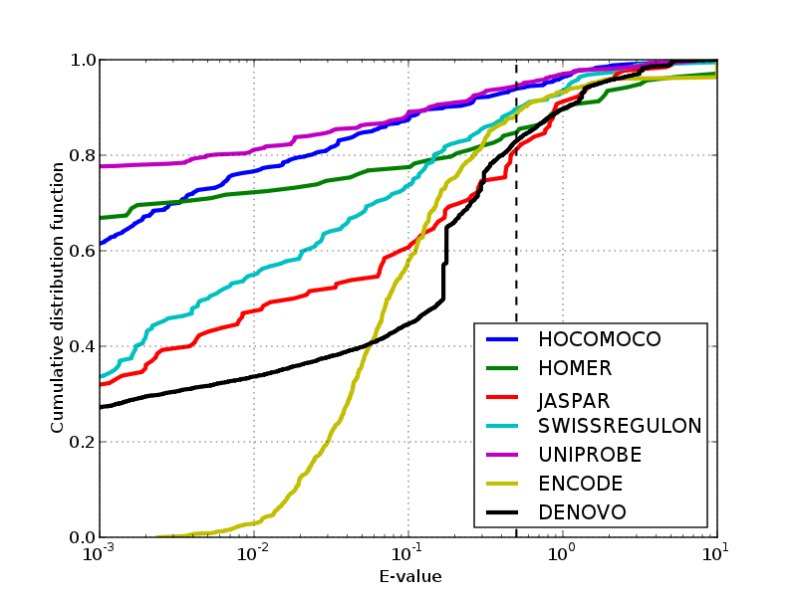
TomTom distance distributions

Slide 5
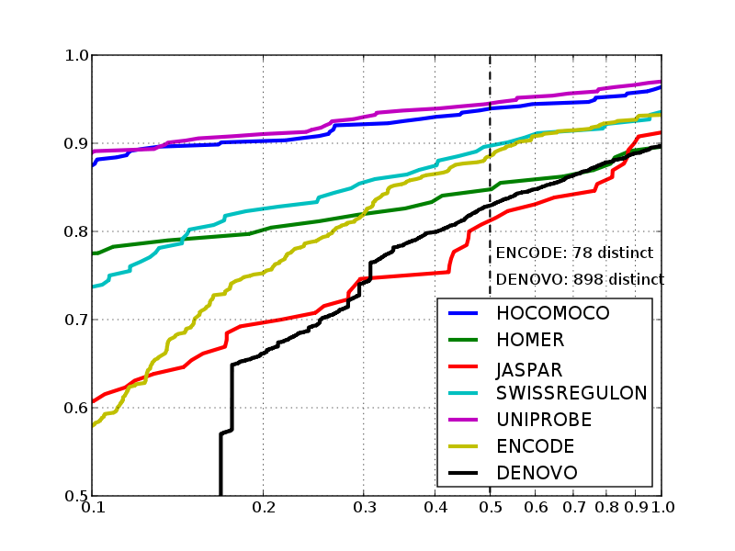
TomTom distance distributions
Cumulative distribution function
E-value

