Slide 1




Early and late changes in gene expression during mineralisation of SAOS-2, a human osteosarcoma cell line model for bone formation.
MR Davis, AJ Carlisle and
KM Summers

Slide 2
Formation of bone
  Osteoblasts lay down collagen matrix
  Two stage deposition of hydroxyapatite mineral on this matrix
    Initial crystals of hydroxyapatite act as nucleation sites for further mineralisation
    Calcium and inorganic phosphate (Pi) required
      Pyrophosphate (PPi) inhibits mineralisation
    Phosphatase activity essential for mineralisation
      Alkaline phosphatase (ALPL),PHOSPHO1, ENPP1
  Osteoblasts become embedded in the matrix
    Osteocytes
  Osteoclasts degrade bone

Slide 3
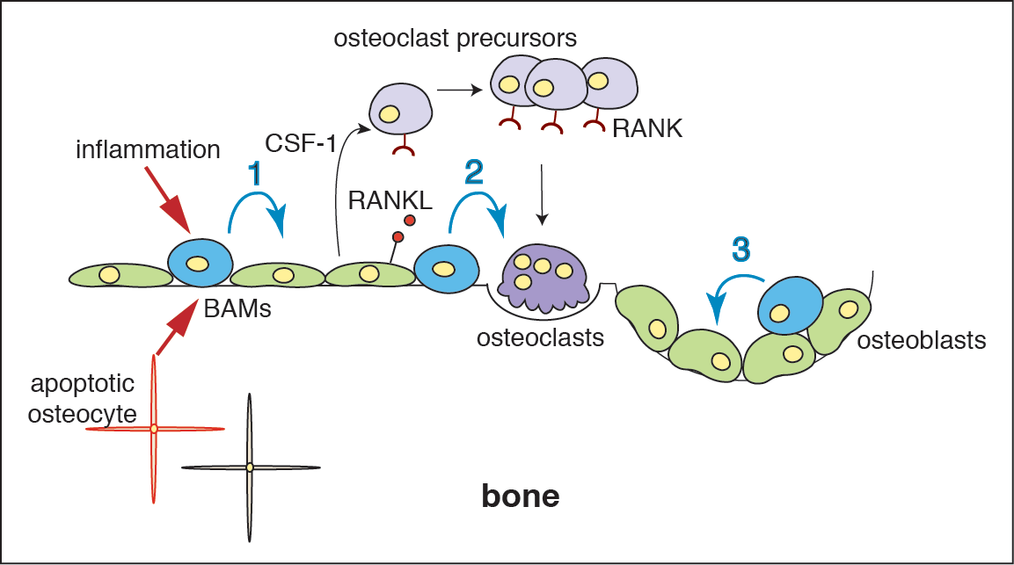
Maintenance of bone
Bone turnover - controlled by the balance between functions of osteoclasts, which break down bone and osteoblasts which replace it. Imbalance – osteoporosis, Pagets disease

Slide 4
Mineralisation of osteoblasts
  In vivo, there is rapid initial mineralisation over the first month (to ~2/3 of final density)
  Continuous mineralisation over subsequent months
  Maintenance mineralisation to replace bone degraded by osteoclasts
    Repairs continuous microfractures
  Little known about early events in mineralisation
  Time course for Fantom5 samples
    0, 15, 30, 45, 60, 80, 100, 120, 150, 180 minutes,
    4, 8, 24 hr,
    4, 7, 14, 21, 28 days of treatment

Slide 5
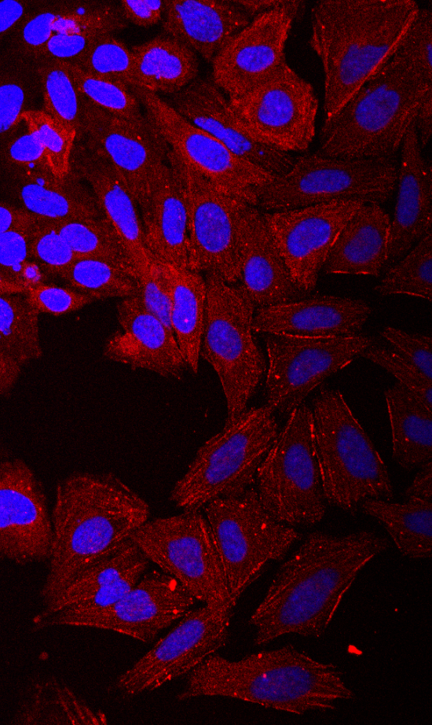
Saos-2 (“sarcoma osteogenic”)
Derived from primary osteosarcoma from 11 year old Caucasian girl in 1973
Heteroploid line
Osteoblastic features
  Deposits a mineralisation-competent extracellular matrix similar to osteoblasts
  Triggered by administration of β-glycerophosphate
  High level of alkaline phosphatase, increasing with time in culture
  Osteonectin (bone specific) positive

Slide 6
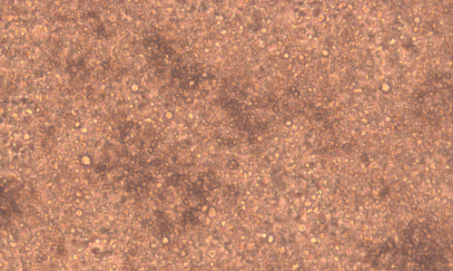
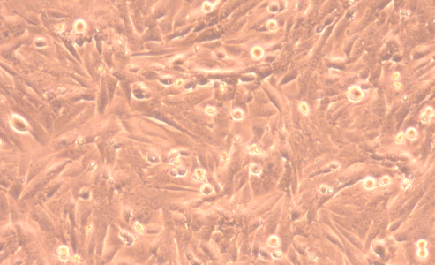
Mineralisation time course
Calcium deposition

Slide 7
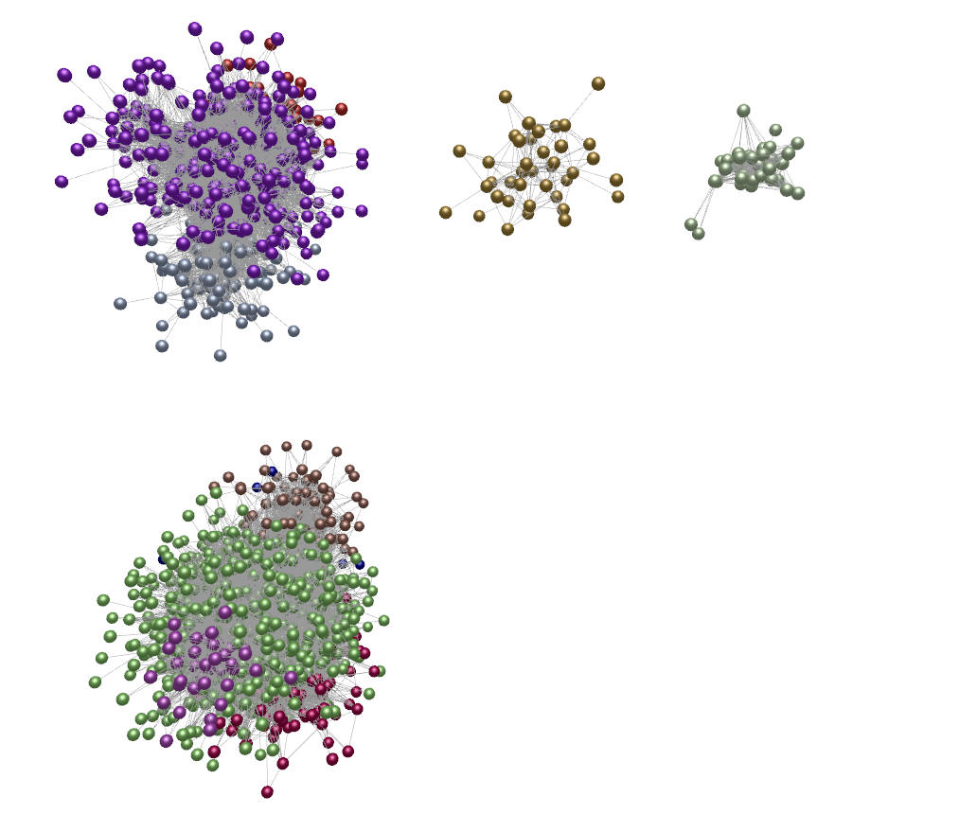
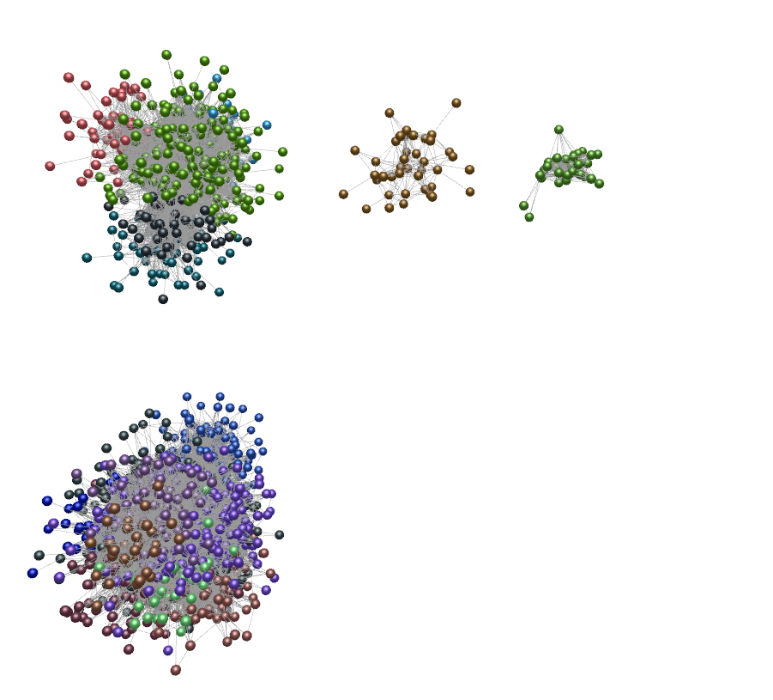
F5 data - cluster analysis
Up-regulated clusters
Finer-level
Clusters
MCL2.2
Down-regulated clusters

Slide 8
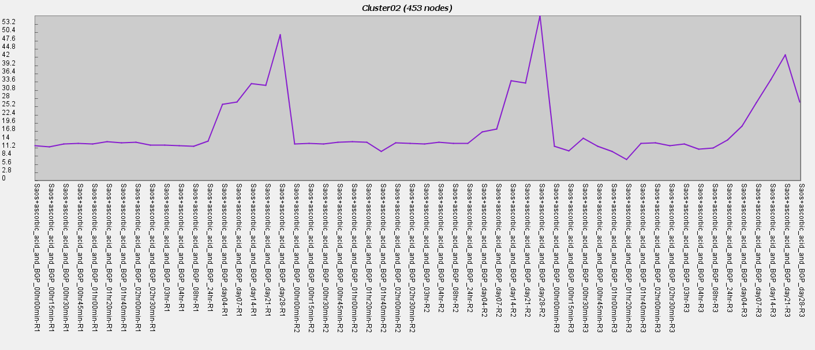
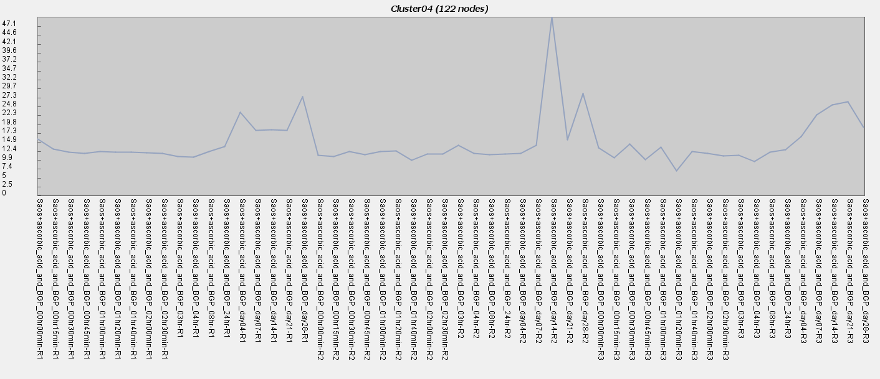
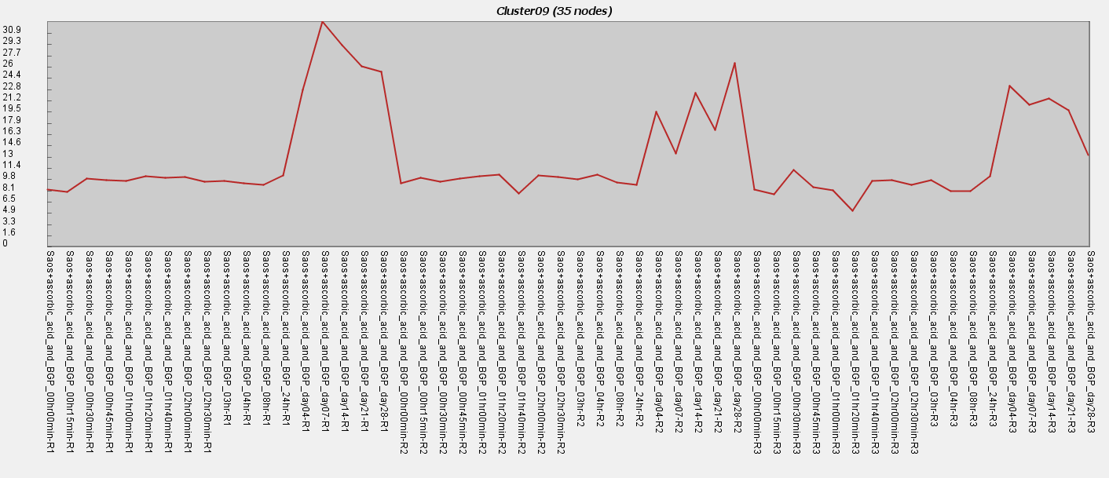
Upregulation
24 hr
7 day
21 day
28 day
24 hr
7 day
21 day
28 day
0 min
1 hr
0 min
2 hr
4 day
30 min
1 hr
2 hr
4 hr
4 day
14 day
0 min
30 min
1 hr
2 hr
4 hr
4 day
14 day
30 min
4 hr
24 hr
7 day
14 day
21 day
28 day
Replicate 1
Replicate 2
Replicate 3

Slide 9
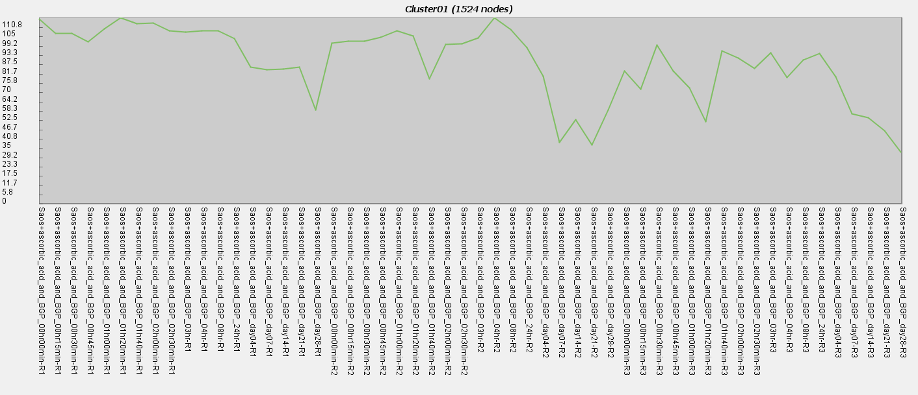
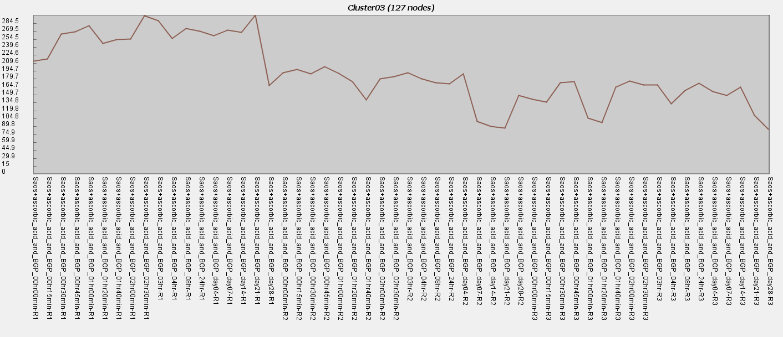
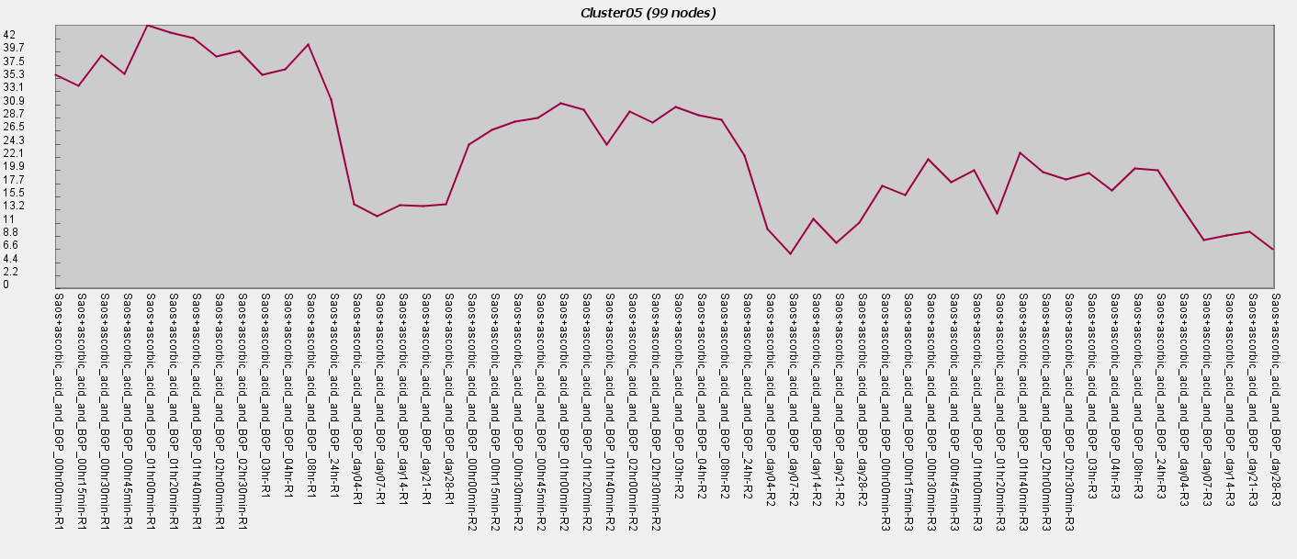
Downregulation
24 hr
7 day
21 day
28 day
24 hr
7 day
21 day
28 day
0 min
1 hr
0 min
2 hr
4 day
30 min
1 hr
2 hr
4 hr
4 day
14 day
0 min
30 min
1 hr
2 hr
4 hr
4 day
14 day
30 min
4 hr
24 hr
7 day
14 day
21 day
28 day
Replicate 1
Replicate 2
Replicate 3

Slide 10
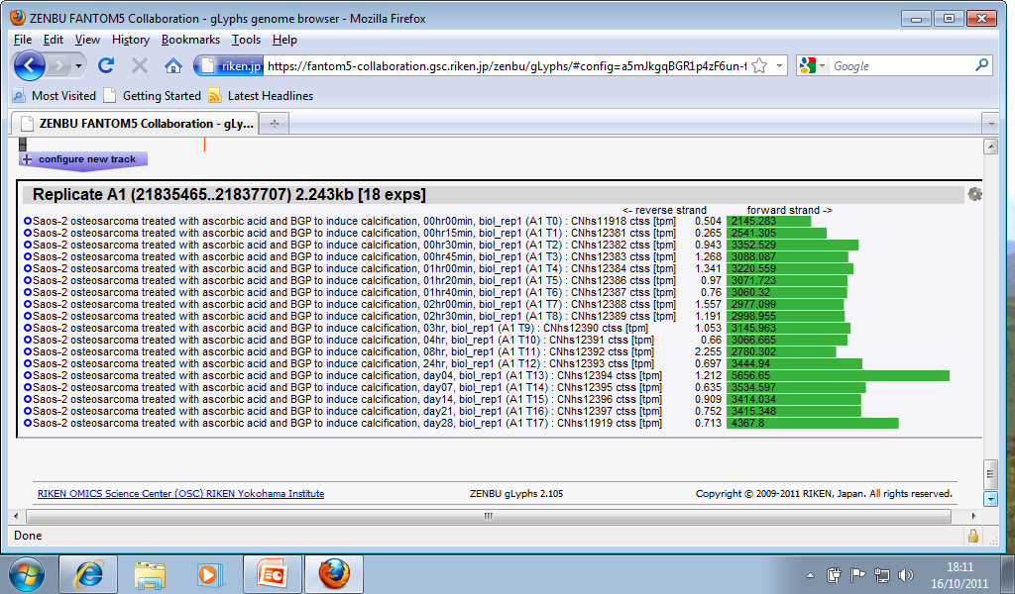
Fantom5 data analysis
Saos data set
0
15
30
45
60
First three hours
80
100
120
150
180
4
8
Four - 24 hours
24
4
7
14
Four – 28 days
21
28
Examples from Replicate A1; other replicates give similar pattern

Slide 11
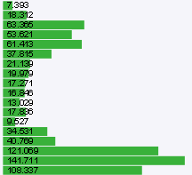
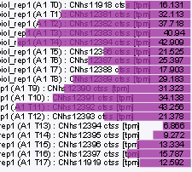
Early genes – FOS and JUN
FOS
JUN
JUN shows a different expression pattern from FOS.
Are there other FOS partners expressed late?

Slide 12
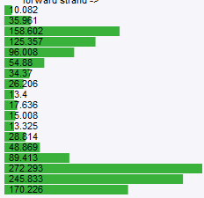
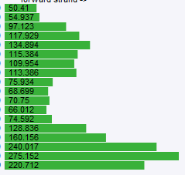
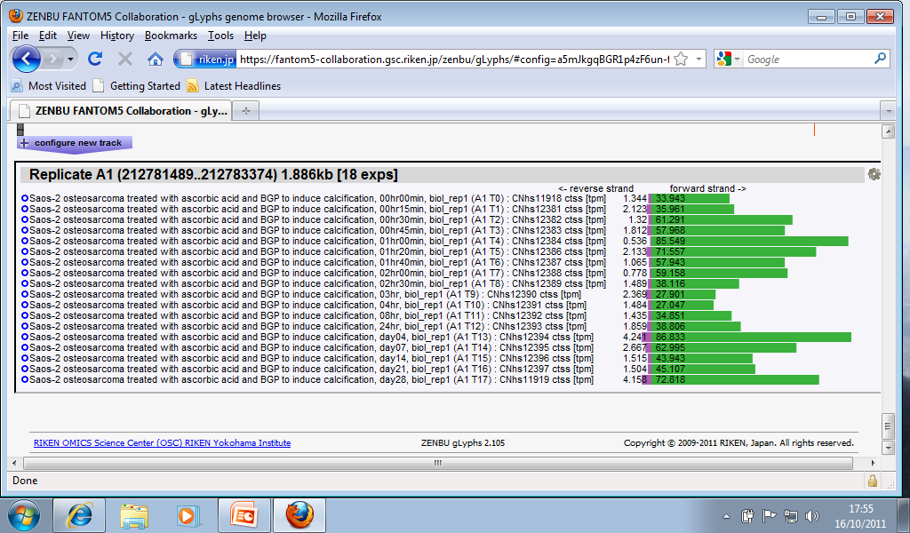
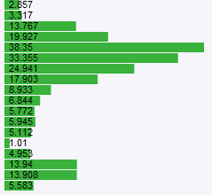
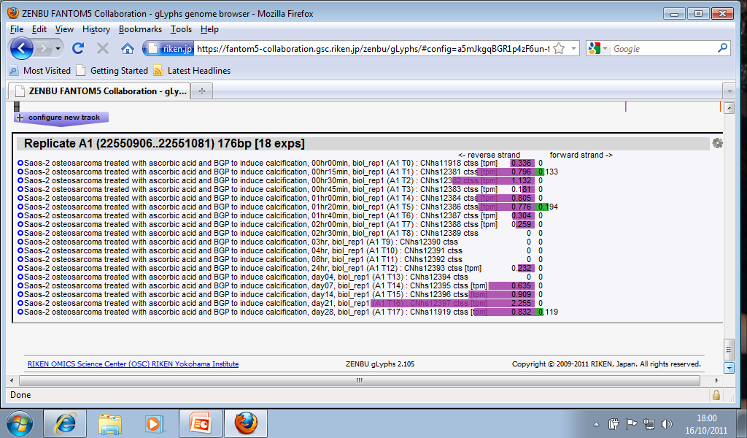
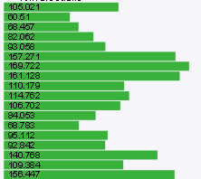
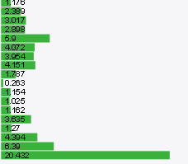
Early genes – AP1 partners
FOS
EGR1
IER2
ATF3
NR4A2
JUNB
FOSB
EGR3

Slide 13
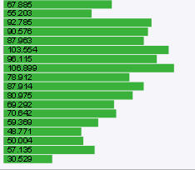
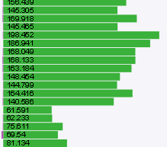
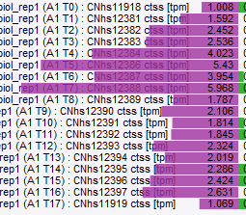
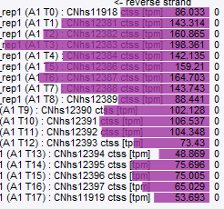
Early genes – AP1 partners
JUN
FOSL1 (FRA1)
FOSL2
NR4A2
DUSP1

Slide 14
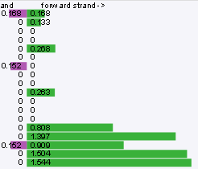
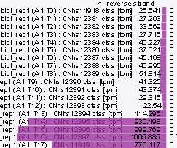
Late markers (osteocyte)
DMP1
SOST

Slide 15
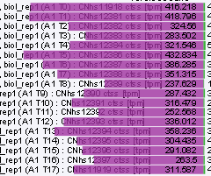
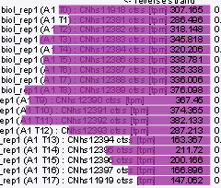
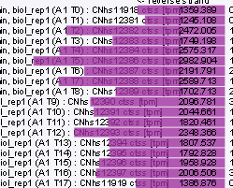
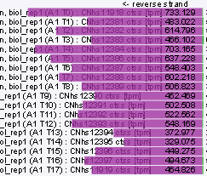

Extracellular matrix genes
ITGB1
PDLIM7 (LMP1)
COL1A1
FN1
COL11A1

Slide 16
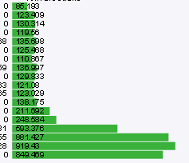
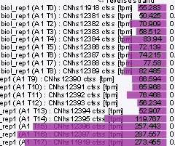
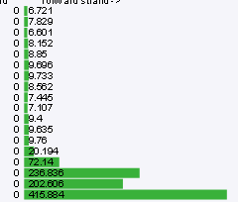
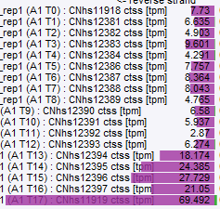

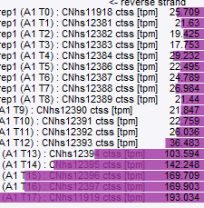
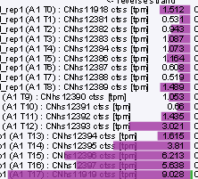

Extracellular matrix genes
COL1A2
COL10A1
COL22A1
BGN
COL3A1: very low expression
SPARC (osteonectin)
COL11A2
COL24A1
DCN

Slide 17
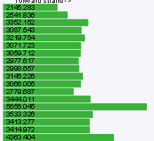
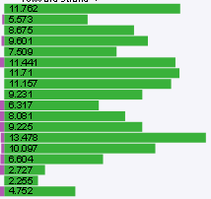
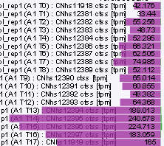
Phosphatase expression
ALPL
ENPP1
PHOSPHO1

Slide 18
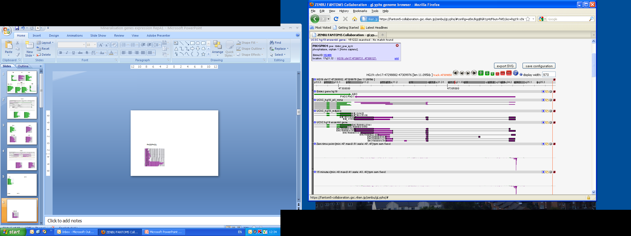
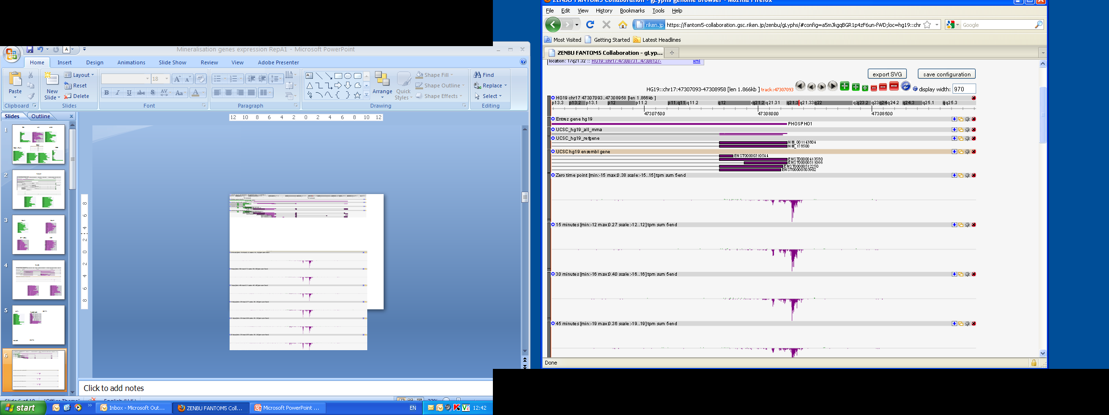
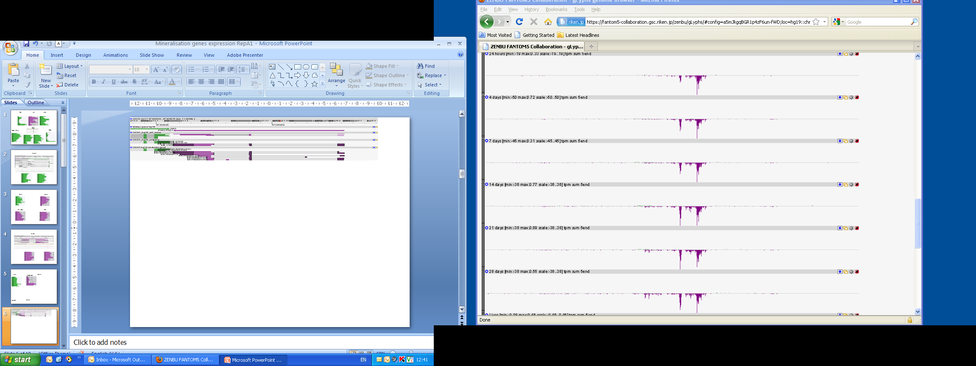
PHOSPHO1
Days after induction
0
1
4
7
14
21
28

Slide 19
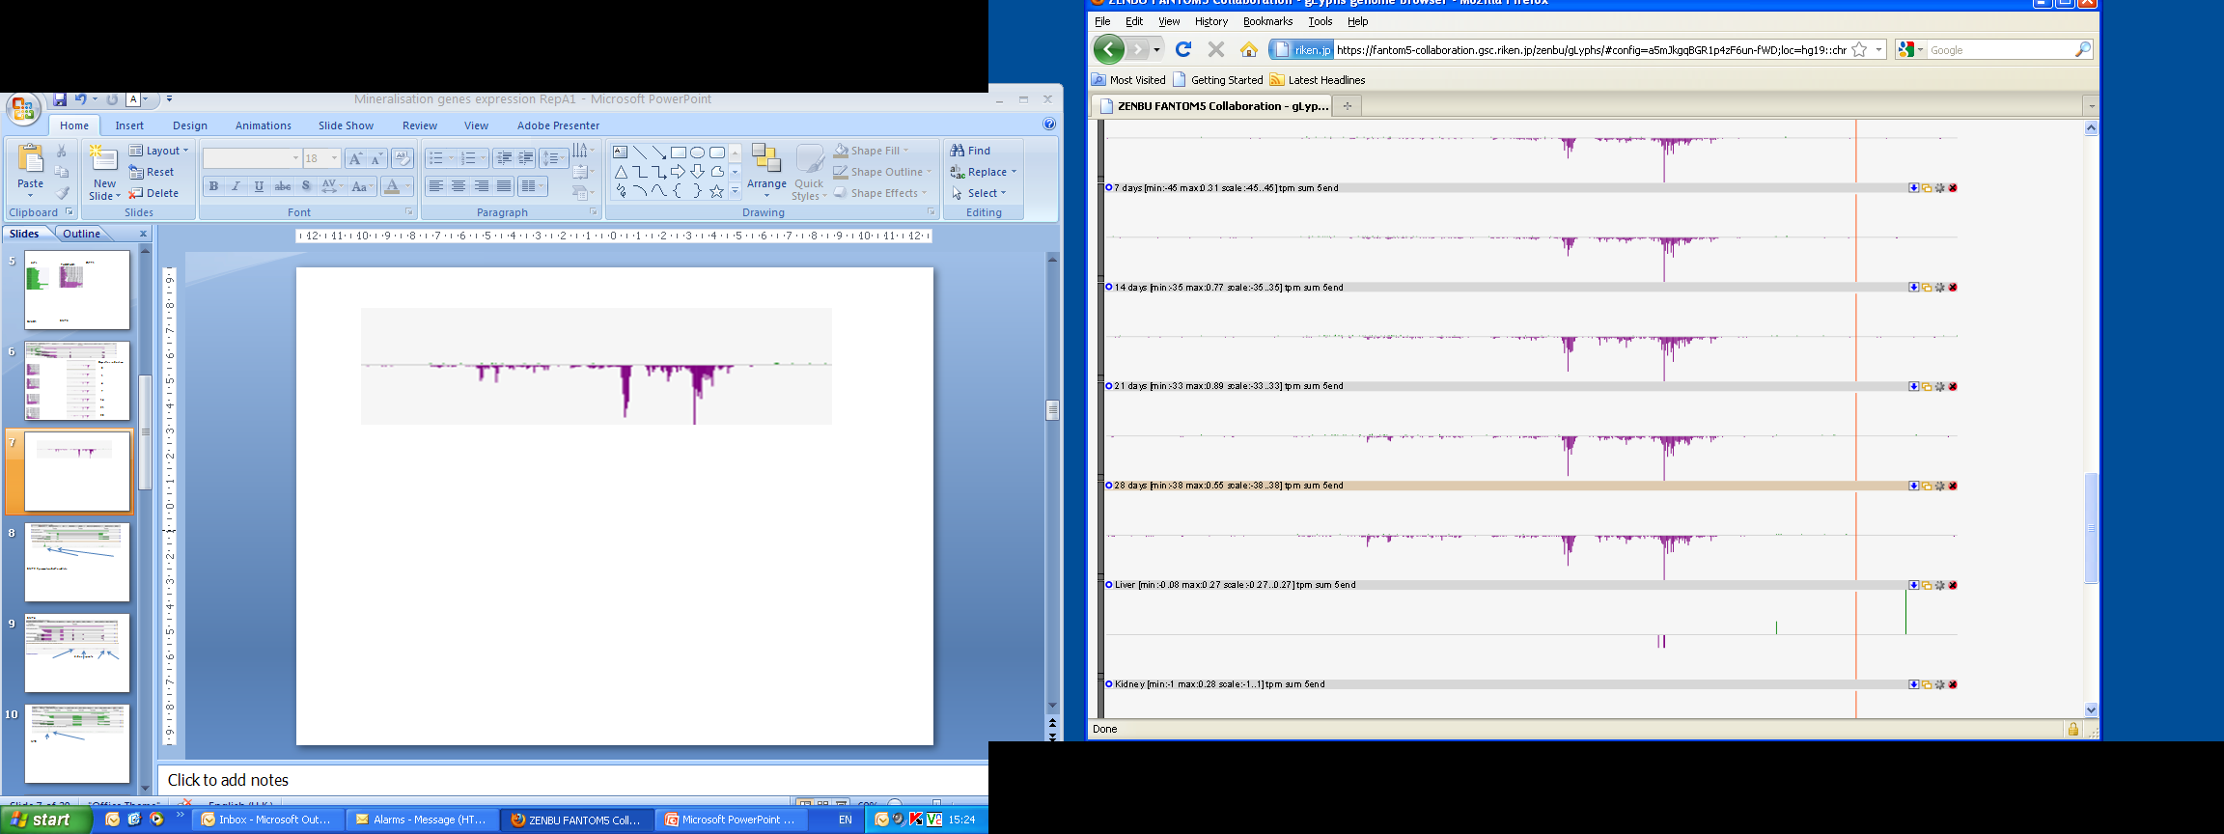
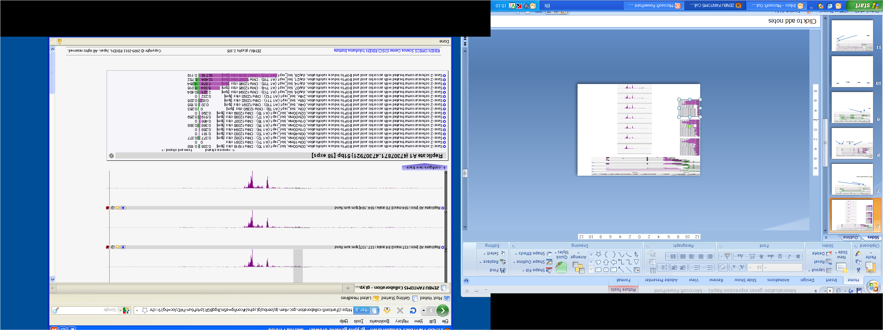
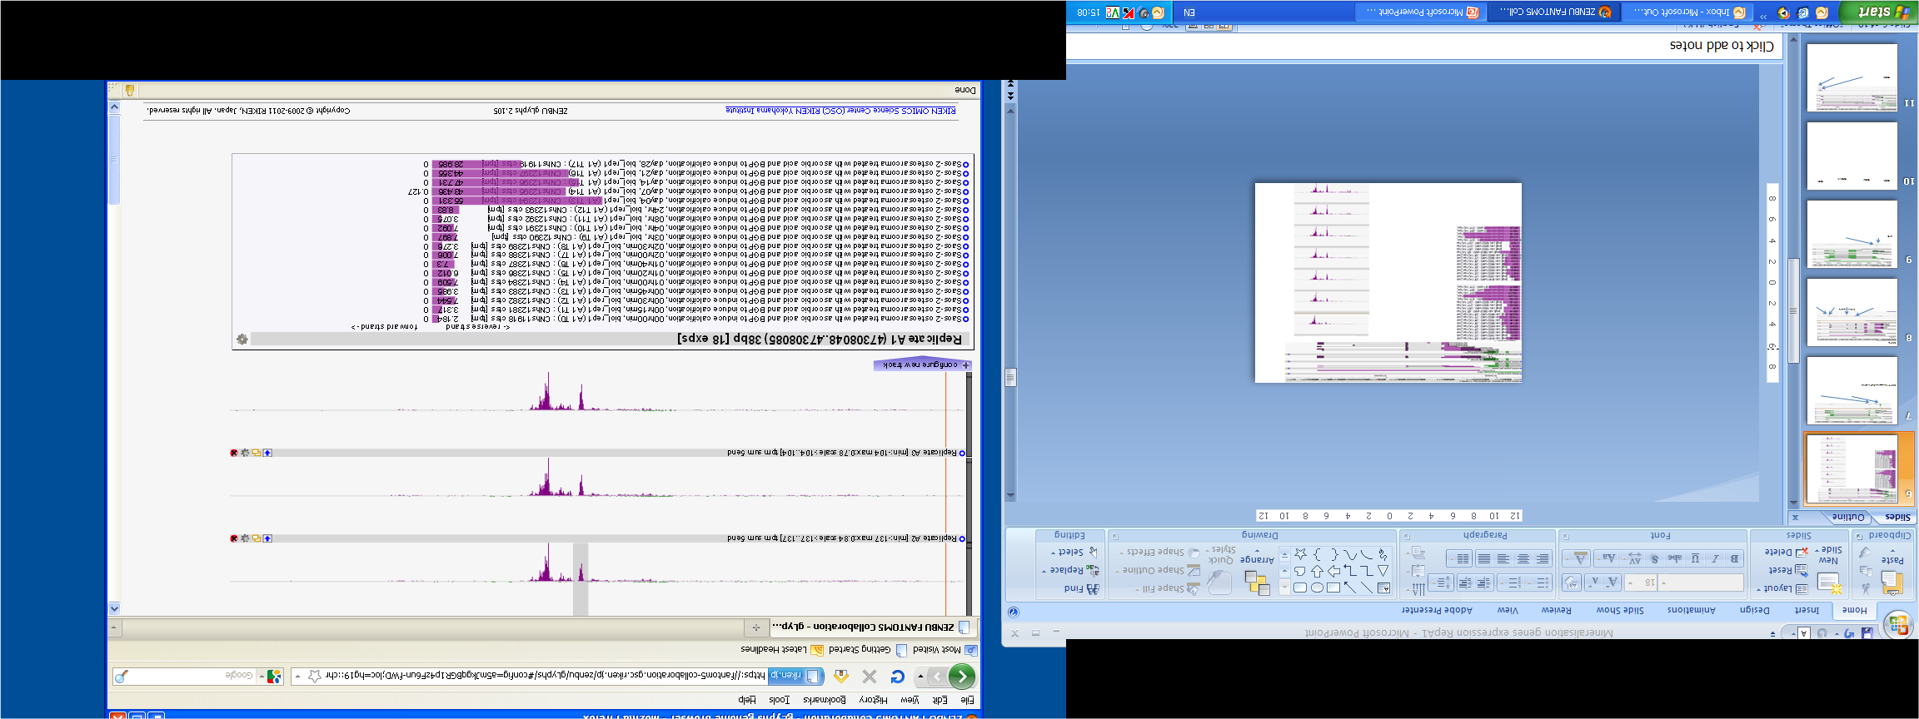
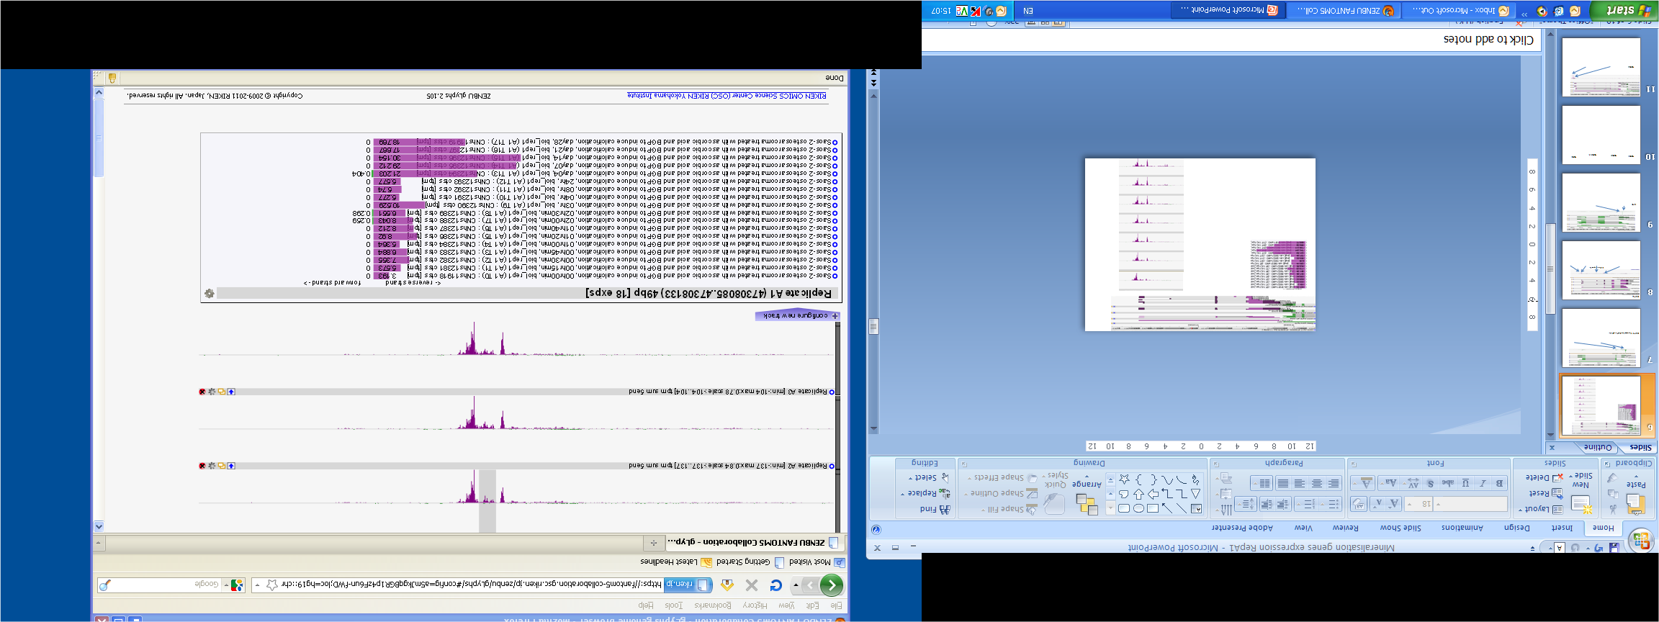
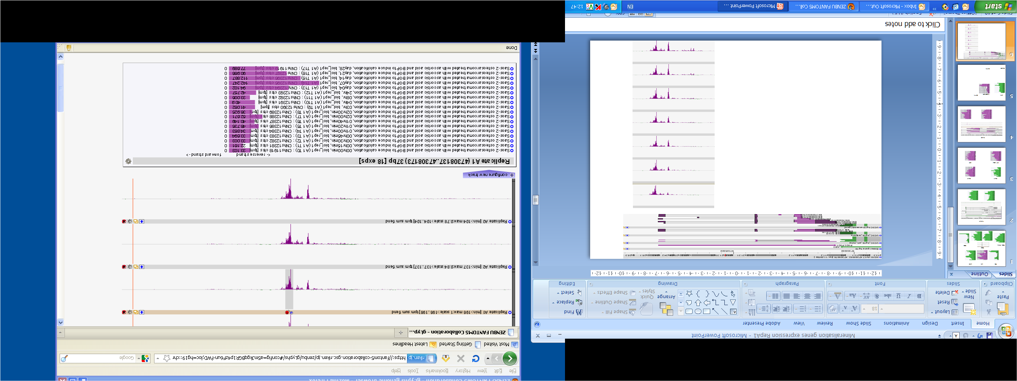
PHOSPHO1

Slide 20
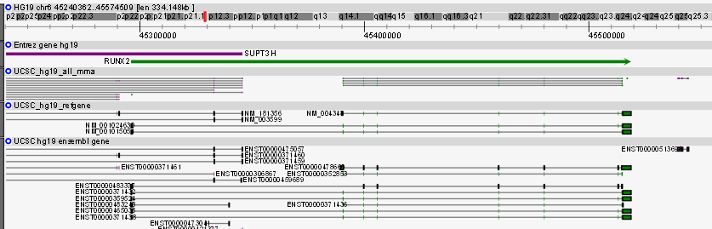



Transcription factors - RUNX2

Slide 21




Transcription factors – TWIST1
TWIST1

Slide 22




Transcription factors
SNAI1
SNAI2
SP7 (OSX)
VDR

Slide 23




TGFβ related genes
TGFB1
TGFB2
TGFB1I1
TGFBI

Slide 24



TGFβ related genes – TGFB3

Slide 25




Bone morphogenic proteins – BMP2

Slide 26






Bone morphogenic proteins – BMP4
Renal endothelial cells

Slide 27





Growth factor – IGF2

Slide 28

Smooth muscle actin – ACTA2

Slide 29

Smooth muscle actin – ACTA2
0
Days after induction
4
7
14
21
28

Slide 30


Smooth muscle actin – ACTA2
Notes:
Increase late in mineralisation more obvious in Rep A2 and Rep A3.
No evidence for second TSS in mouse – no cluster and no published transcripts near FAS gene eg in diffentiation of MSc to oocytes.

Slide 31


Issues
  Variability between replicates
    Biological system – some variability inevitable
Replicate 1
Replicate 2
Replicate 3

Slide 32
Issues
  Cells become hyperconfluent during the mineralisation process
  How many of the differences are due to cell growth not mineralisation?
To be compared with:
  Saos-2 untreated (same time course)
  MG63 osteosarcoma cell line
    Fails to mineralise

Slide 33
The SAOS2 model
Retains many characteristics of osteoblasts
  Classic osteoblast marker expression patterns
  Some expression patterns reflect status as tumour line
Early events include transient upregulation of AP1 genes
  Some of these upregulated again late
Late events include upregulation of ECM proteins
Evidence for promoter switching
  During time course
  Tissue limited promoters
Investigation of TFBS to come

Slide 34

Maggie Davis
Ailsa Carlisle
David Hume
Tom Freeman
RIKEN OSC and FANTOM5

