Slide 1
Data Analysis using the FANTOM5 Ontology
Chris Mungall
Lawrence Berkeley Laboratory

Slide 2
Outline
What is the FANTOM5 Ontology
what’s it for
what is an ontology anyway?
building the ontology and annotating the F5 samples
Exploring samples
FONSE : faceted ontology browsing
Using the ontology for analysis in the FANTOM project

Slide 3
Data onslaught
Increasing number of cells, cell lines and tissues being sequenced
cell lines
in vivo cells
tissue samples
Sample source metadata is essential
data tracking
answering biological questions
Solution:
annotate samples using ontologies

Slide 4
FANTOM5 ontology
A ‘GO’ for samples
Uses
Drive user interface, search
FONSE web interface
Data management and provenance
Biological questions and interpretation
What biological attributes are enriched in these CAGE signals?
How does the transcriptome of cell lines differ from their in vivo counterparts

Slide 5
How can we classify samples?
Temporal/lineage
Species
Developmental Lineage
Timecourse
Spatial
Organ
Organismal subdivision
Function/dysfunction
Organismal system
Disease
Experimental
Treatment
Cell line
Multiple axes of classification

Slide 6
myxofibrosarcoma cell line:MFH-ino, rep1
Temporal/lineage
Species : human
Developmental Lineage
Timecourse
Spatial
Organ : skin
Organismal subdivision : surface
Function/dysfunction
Organismal system: integument
Disease : hystiocytoma
Experimental
Replicate? : rep1
Treatment
Cell line : fibrosarcoma cell line
No single axis of classification
is sufficient for all purposes

Slide 7
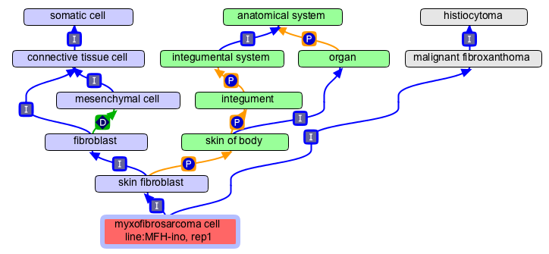
Ontologies and multiaxial classification
mesenchymal cell
is a subclass of
connective tissue
cell
ph
=
skin fibroblast
is equivalent to
any fibroblast that is part_of
some skin of body
D
every fibroblast
develops_from
some mesenchymal
cell

Slide 8
Description logics and reasoning
mesenchymal cell
⊆ connective tissue
cell
ph
axioms
=
Transitive(is_part_of)
Transitive(develops_from)
fibroblast
⊆ develops_from
∃ mesenchymal cell
D
skin fibroblast ≡ fibroblast ∩ is part_of ∃ skin of body
skin fibroblast ⊆ develops_from ∃ connective tissue cell
entailments
skin fibroblast ⊆ part_of ∃ integumental system
myxofibrosarcoma ⊆ derives_from ∃ part_of ∃ integumental system

Slide 9
Constructing the FANTOM5 ontology
1000s of samples…
Multiple means of classification…
A large feat of knowledge engineering…
Thankfully, help is at hand
http://obofoundry.org

Slide 10
Ontologies connect biological knowledge
FANTOM5 Ontology
Cell Ontology (CL)
BTO Cell Lines
Disease Ontology
Experimental Factor Ontology
GO Cell Part
Uberon
(metazoan gross anatomy)
GO Bio Proc.
Protein Ontology
FMA
MA
EHDAA

Slide 11
Leveraging Multiple Ontologies
Uberon
(gross anatomy ontology)
DO
(disease ontology)
CL
(cell ontology)
ph
=
Samples are leaf nodes
in the FF ontology
FF:10600-108E6
FF
(FANTOM Five ontology)

Slide 12
Ontology Construction
OBO Domain Ontologies
Expert knowledge
Automated reasoners
F5 Ontology
Automated entity recognition
FF:11294-117A7
{Chicken} {Mesenchymal stem cell}s – {bone marrow} derived, {donor1}
Manual editing
Automated reasoning
CL:0002540 ! mesenchymal stem cell of the bone marrow

Slide 13

Exploring the F5 Ontology
Ontology Environment
OBO-Edit
Protégé 4
Download
Obo format (F5 ftp site)
OWL RDF/XML
Custom tabular formats
Web interface
FONSE : Fantom ONtology Sample Explorer
Temporary URL:
http://yuri.lbl.gov:8600/fonse/
(ask me for the password)

Slide 14
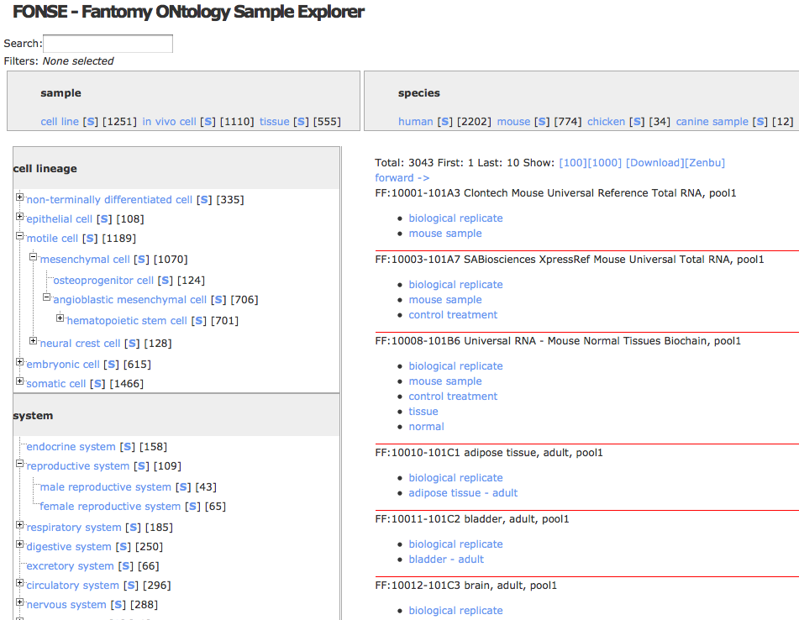

Slide 15
# of
samples
select to filter
sample
classification
facet
# of reproductive system samples

Slide 16
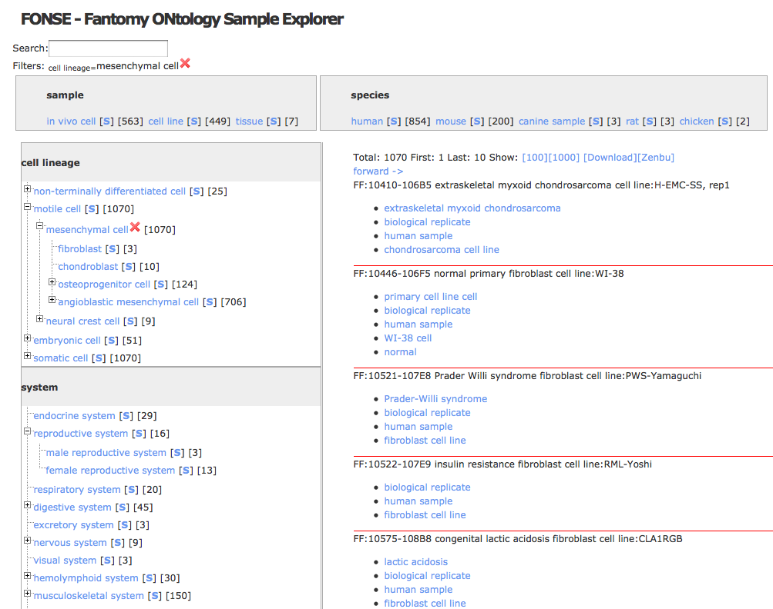
filters selected
# of mes.
samples
reproductive system AND mesenchymal

Slide 17
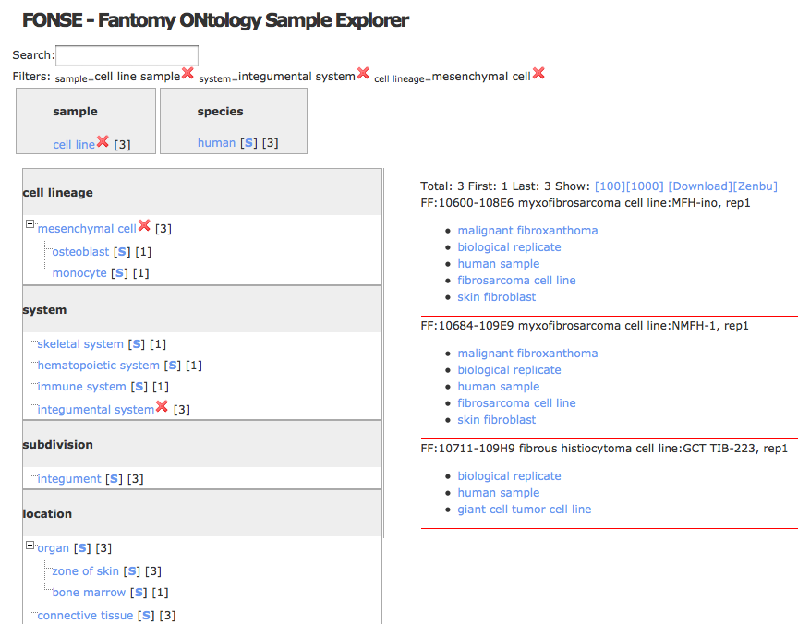
send to Zenbu

Slide 18
Enrichment Analysis
One of the main uses of the GO is for enrichment analysis
Can we do the same for sample data?

Slide 19
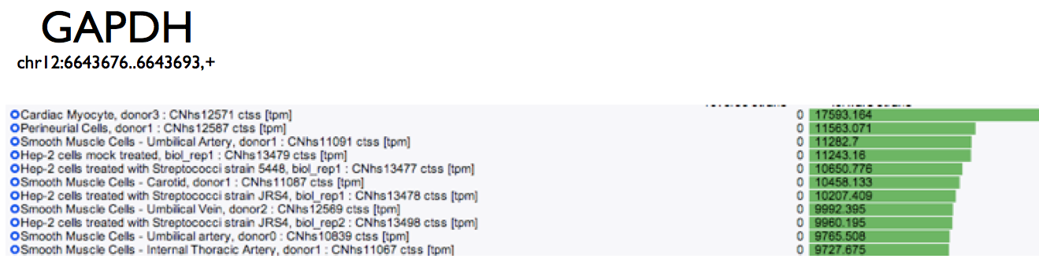
Sample SpecificCAGE peaks
(global analysis without cell lineage info.) kawaji@gsc.riken.jp
Aug 17th, 2011

Slide 20
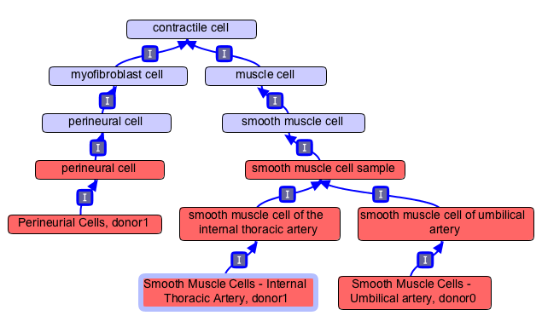
3/3
2/3

Slide 21
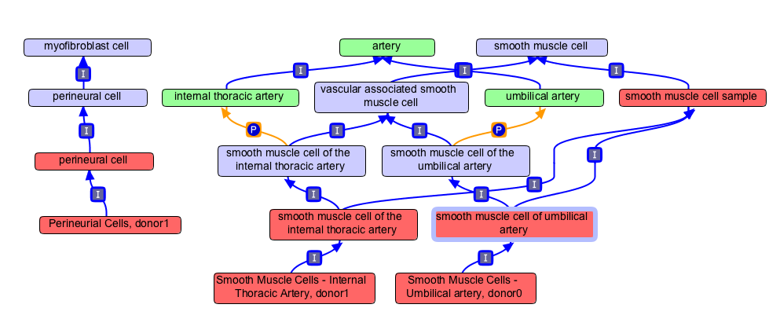
arterial smooth muscle cell

Slide 22
Future Directions
Browser Improvements
Visualization
Hook to into GO Galaxy
(http://galaxy.berkeleybop.org)
Better integration with ZENBU
Ontology Improvements
Update 13
Better treatment of time courses
Tidy up relationship types
Apply to other F5 analyses
sample bias?

Slide 23
Conclusions
Ontologies provide more than data tracking
The F5 Ontology is a rich evolving resource leveraging detailed knowledge encoded in multiple external ontologies

Slide 24
Acknowledgments
Cell Ontology
Terry Meehan
Alexander Diehl
Terry Hayamizu
Suzanna Lewis
Judith Blake
FANTOM5 Consortium
All members, in particular
Kawaji Hideya
Winston Hide
Alistair Forrest

